Slide 1
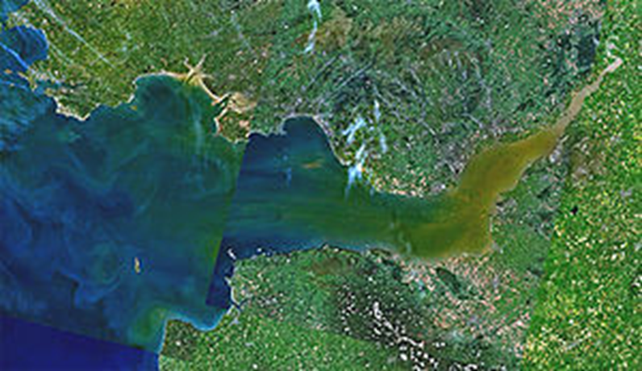
Living on the Smile
A personal view of life on the Bristol Channel, once known as The Severn Sea
Raye Green
Notes:
Until Tudor times the Bristol Channel was known as the Severn Sea, and it is still known as this in both Welsh: Môr Hafren and Cornish: Mor Havren. In the middle stone age the ocean only came inland as far as Lundy. The rest of the channel was a plain.

Slide 2
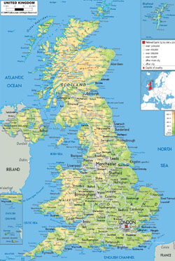
Great Britain is the name of the main island of the British Isles.
Notes:
…and it is the most recognisable island on the globe – in my opinion! Britain became the United Kingdom in 1707.

Slide 3
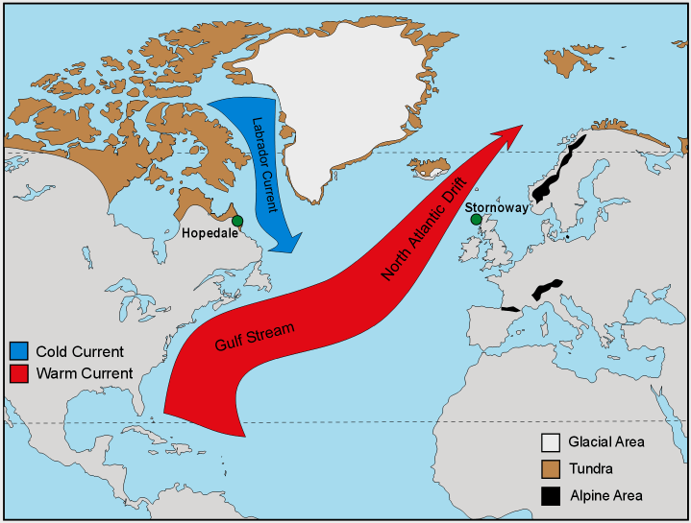
The Gulf Stream
The Gulf Stream, together with its northern extension towards Europe, the North Atlantic Drift, is a powerful, warm, and swift Atlantic ocean current that originates at the tip of Florida, and follows the eastern coastlines of the United States and Newfoundland before crossing the Atlantic Ocean.

Slide 4
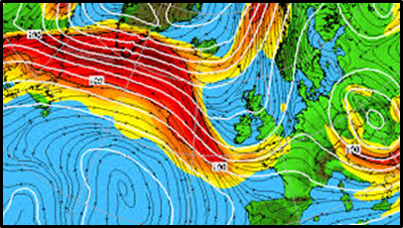
The Jet Streams
Britain is affected by both the north polar jet stream and the sub -tropical jet stream [shown above]. Both follow meandering paths and are major contributors to our wildly variable weather.

Slide 5
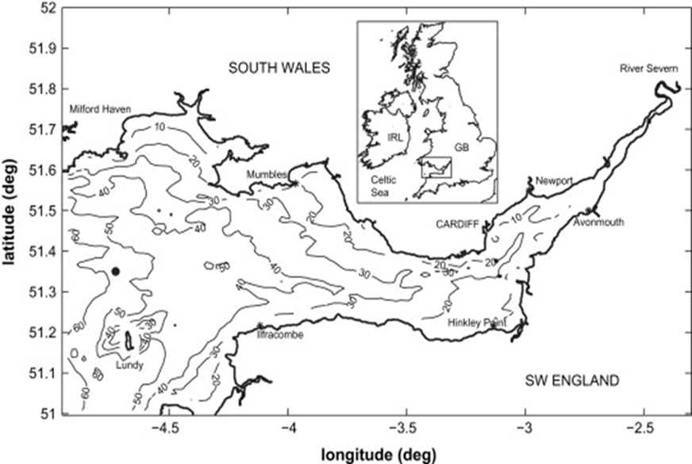
A sketch map of the smile
Question: Where does the Bristol Channel end and the Severn Estuary begin?
Notes:
Answer: Sand Point

Slide 6
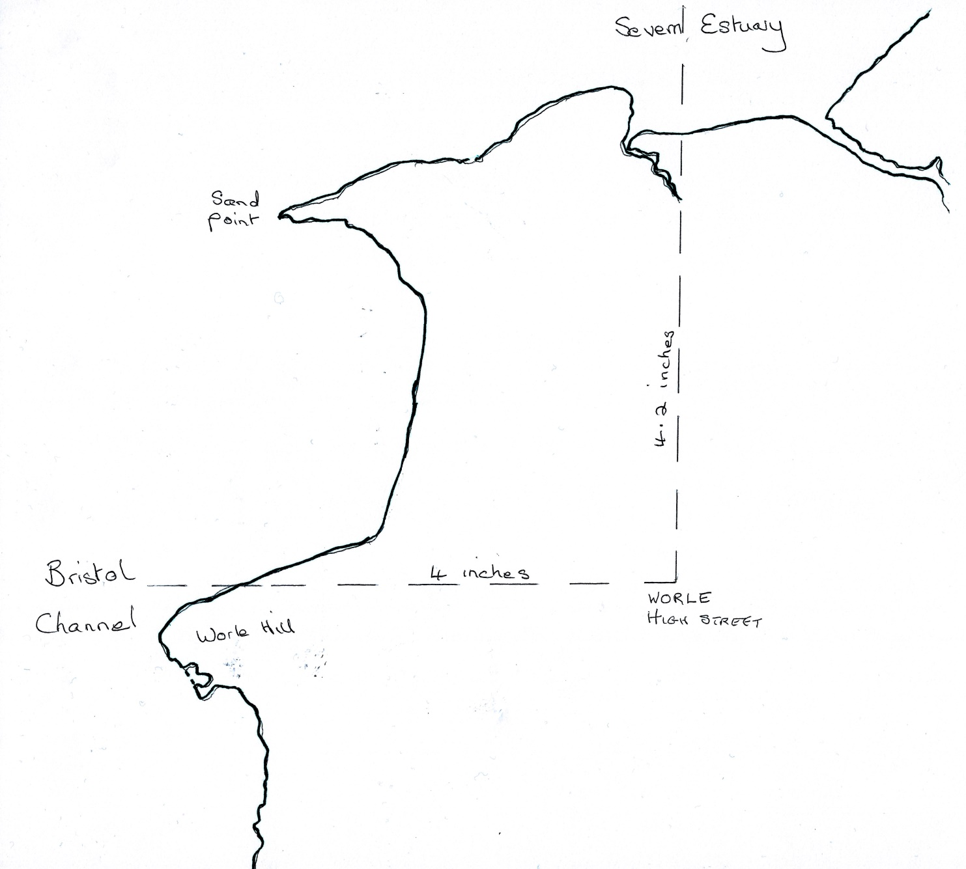
Notes:
Point out the map on the table showing the north and west measurements.

Slide 7
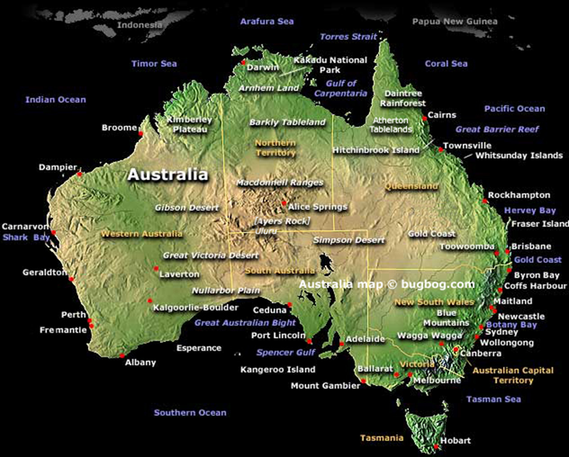
Australia is the major land mass in Australasia, often referred to as a continent. However it is not joined to any other land above water level, so it is also an island

Slide 8
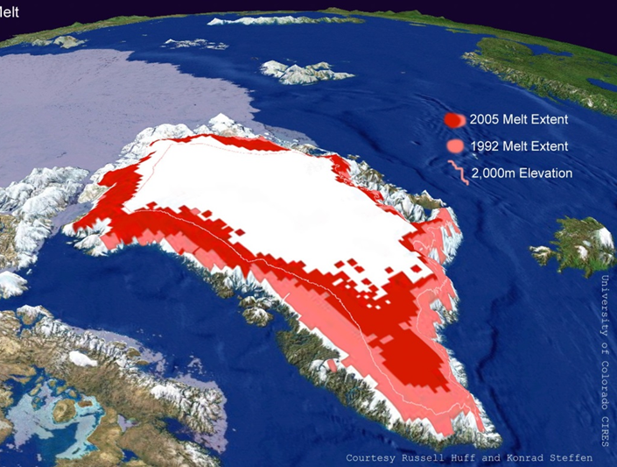
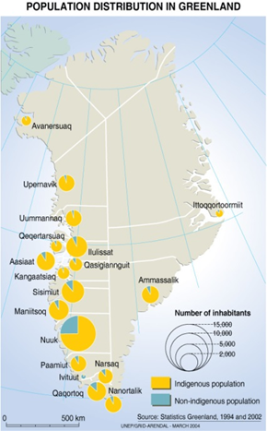
Greenland. Well is it green?
Notes:
So how did it get its name “Greenland” when it's not really green? It actually got its name from Erik The Red, an Icelandic murderer who was exiled to the island. He called it “Greenland” in hopes that the name would attract settlers.

Slide 9
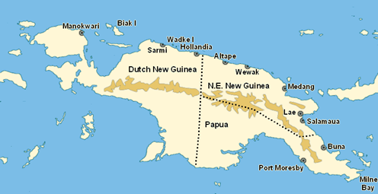
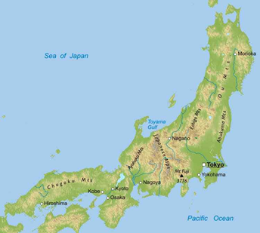
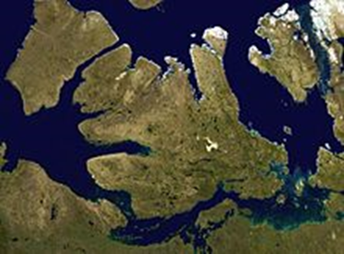
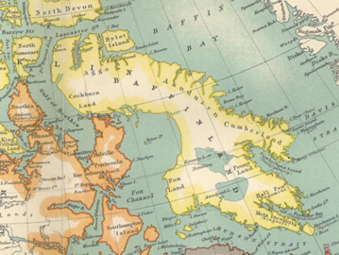

Slide 10
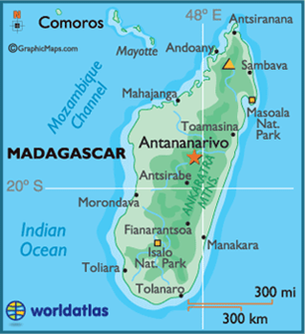
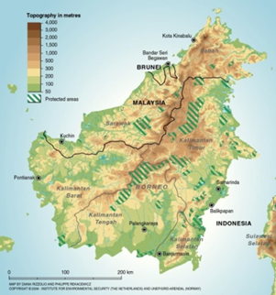
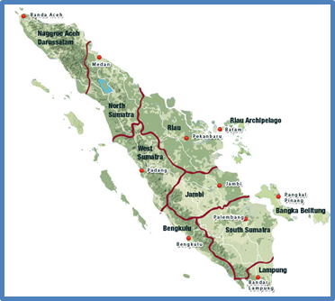

Slide 11
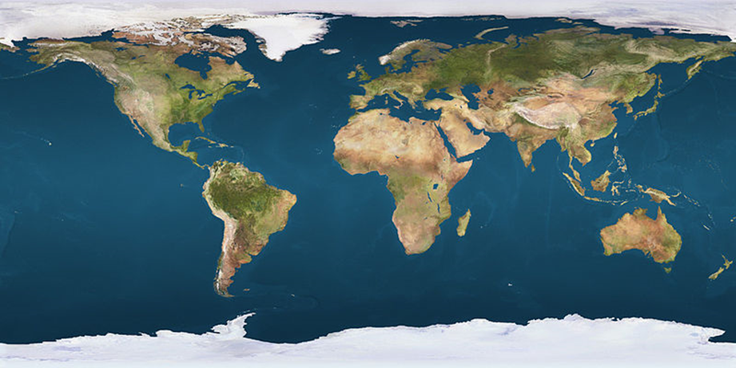
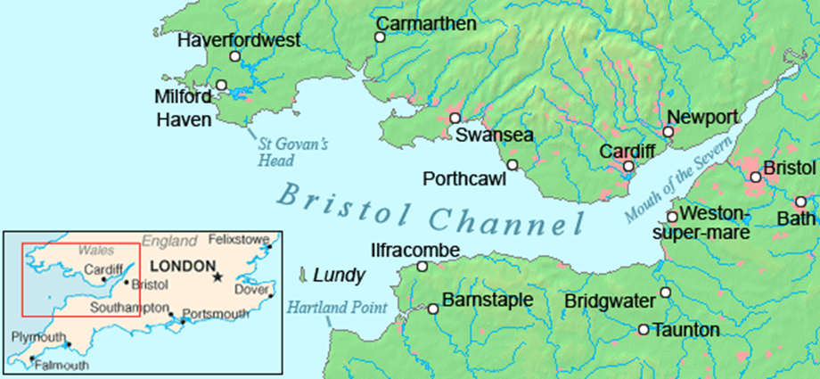

Slide 12
Shipwrecks in the Bristol Channel
Bristol Packet - 1808
The Neptune - 1831
Lizzy - 1854
Eiffel Tower - 1894
Nornen - 1897
Salado - 1897
Verajean - 1908
Cambo - 1912
Bengrove - 1915
Pilton - 1924
Pelican - 1928
Tafleburg, 1941
Walter L M Russ – 1945
Notes:
Are there any more in the last 80 years?

Slide 13
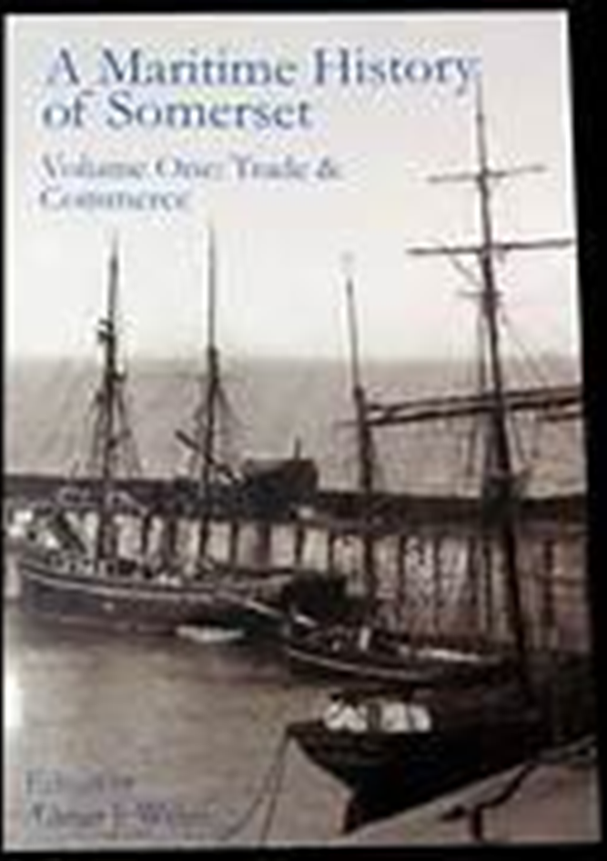
A Maritime History of Somerset is edited by Adrian Webb. There are 8 major contributors, Brian Austin being one of them.

Slide 14
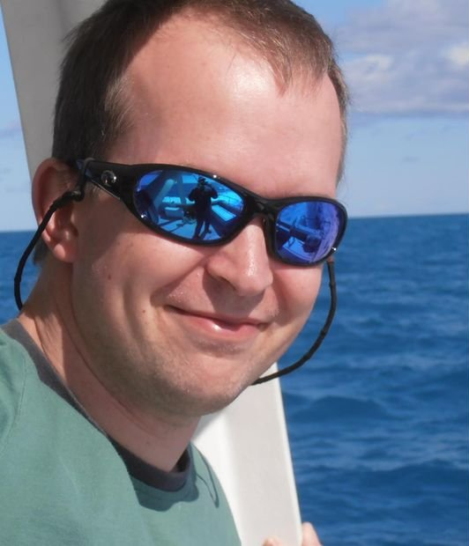
Adrian Webb has edited two volumes for the Somerset Record Society and is Somerset editor of Somerset and Dorset Notes and Queries. He serves as a trustee of the Somerset Archaeological and Natural History Society and as chairman of its publication committee. In 2010, when the book was published he was studying for his PhD at the University of Exeter.

Slide 15
Contact Details for Adrian
www.somersethistory.com
Also Adrian’s Facebook page about Somerset maps and charts -
www.facebook.com/somersetmapsandcharts/
And, finally, he edits the Somerset section of Somerset & Dorset Notes & Queries that has been going since 1888 -
www.sdnq.org.uk/

Slide 16
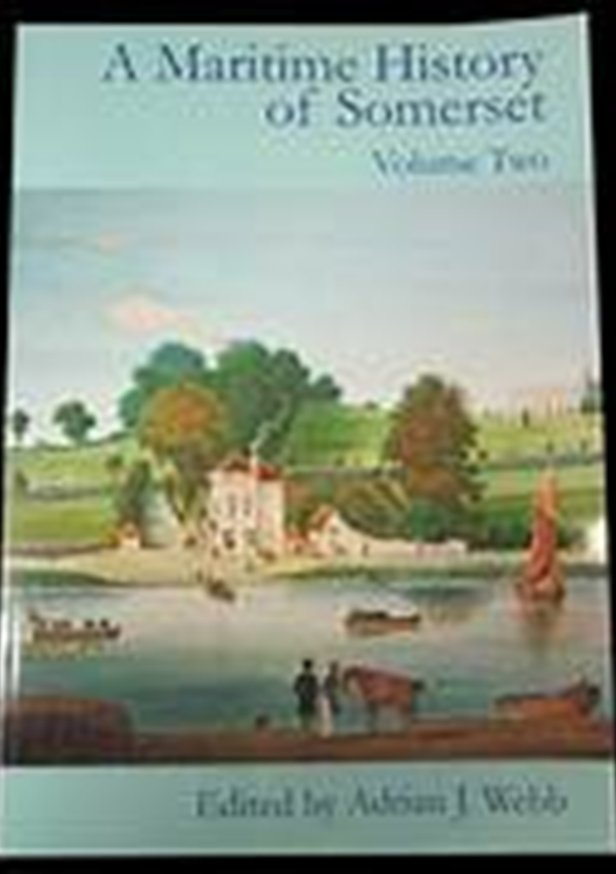
Volume 2 is of special interest because it concentrates upon Travel and Tourism.

Slide 17
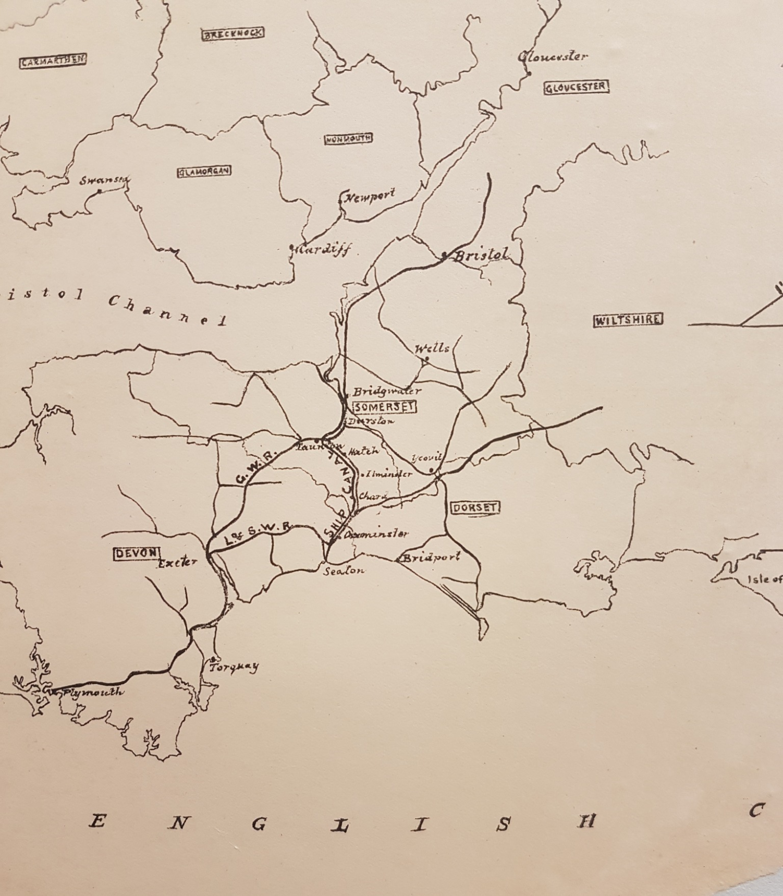
Undated map showing a proposed canal to join the Bristol Channel to the English Channel. Bridgwater to Seaton!

Slide 18
Aust Ferry Crossing
The Severn Estuary's Aust Ferry remembered 50 years on - 2016
Fifty years after its closure, the Aust Ferry was remembered in a special film broadcast on BBC One.
The ferry was once the only way to cross the Severn Estuary by car - so avoiding a two-and-a-half hour detour by road.
During its lifetime it carried some 500,000 vehicles across the estuary for the princely sum of 30 to 63 pence.
The service ended in 1966 - the day before the Severn Bridge was opened.
The programme was broadcast on Inside Out West on Monday 10 October 2016 at 19:30 BST
Subsection
Bristol
Published
10 October 2016

Slide 19
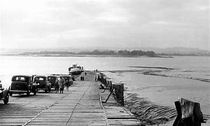
Aust Ferry Crossing 1950s

Slide 20
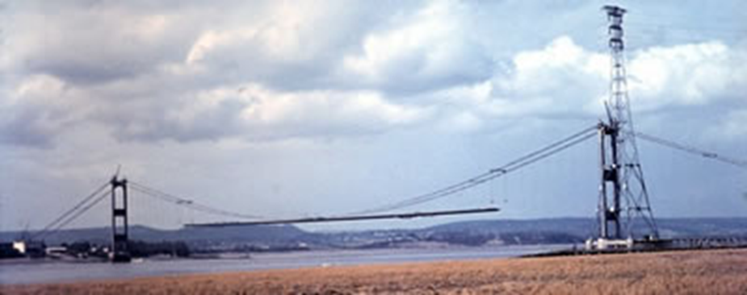
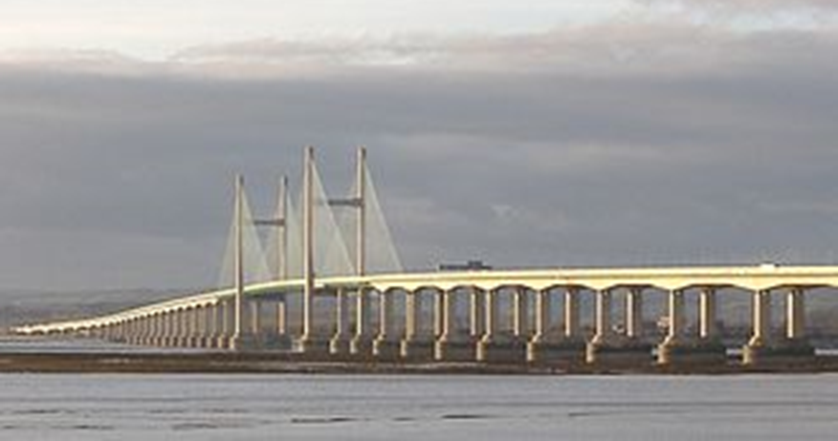
Our two Severn Bridges

Slide 21
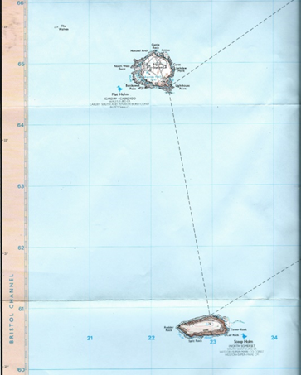
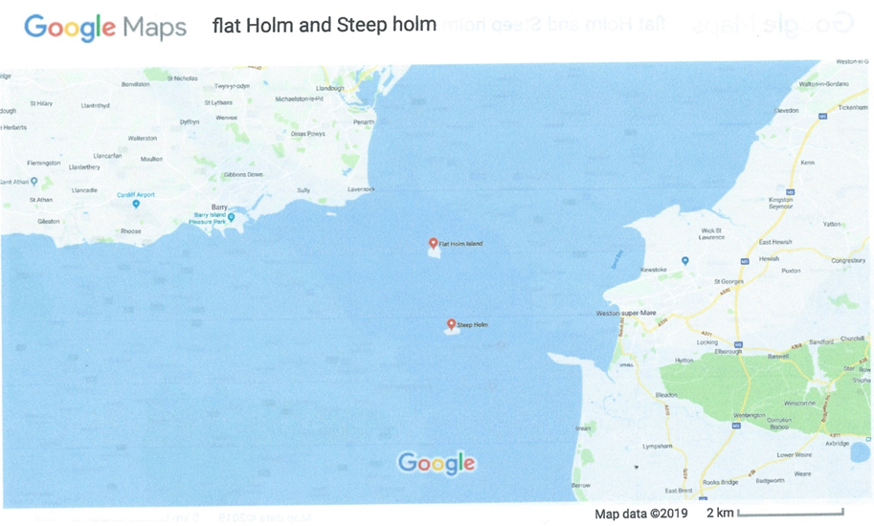
Flat Holm and Steep Holm
Little pals in the Severn Sea

Slide 22
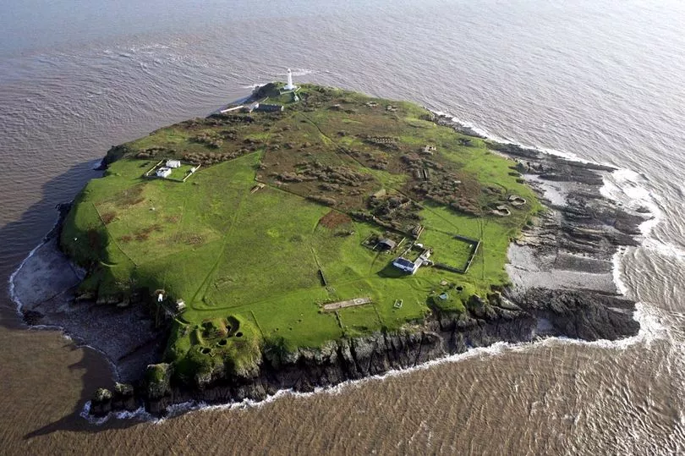
Flat Holm

Slide 23
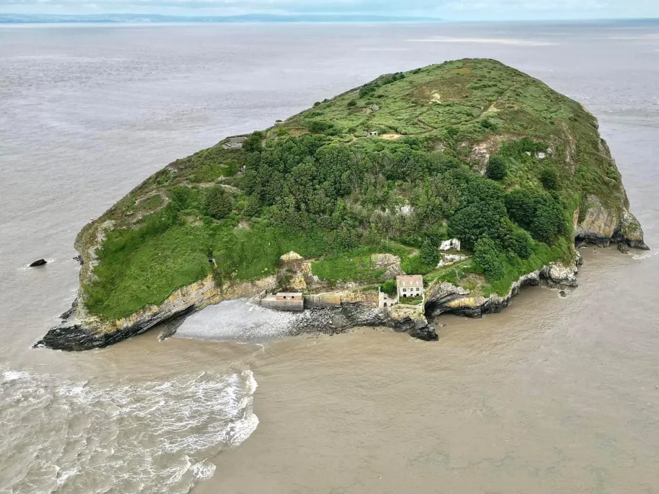
Steep Holm

Slide 24
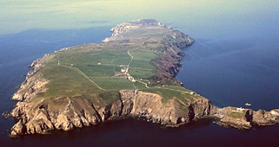
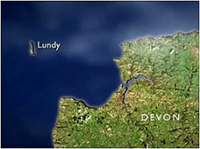
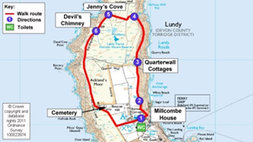

Slide 25
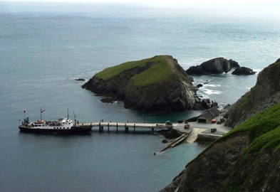
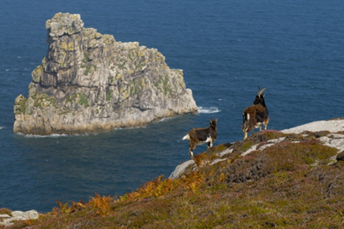

Slide 26
So, just to round things off:
We live on the happy smile of the 10th biggest island on our lovely little planet and this deserves a farewell limerick.
If you think you can sense animosisty,
Try to avoid an atrocity
On the SMILE we are nice
Just like sugar and spice
So we recommend GENEROCITY.

