Slide 1
Bristol Channel Wrecks
The Severn Estuary and the Severn Sea

Slide 2
Remains of The Bristol Packet 1808 – Madbrian Sands, Minehead
Notes:
Packet was built in 1801, but by whom?

Slide 3
Bristol Packet off the coast at Minehead. Taken by Paul Feeney

Slide 4
The Neptune struck a rock on 28th November 1831at Porthkerry, near Barry
Notes:
Sailing Vessel but no more information. Sailing from Newport, south Wales to Wexford in Ireland

Slide 5
Lizzy, The Ketch

Slide 6
Eiffel Tower photo dated 1894

Slide 7
Eiffel Tower, the ship!!!!!!
1st October, 1894:
Ran aground on Cold Knap Point at Barry in South Wales
Refloated at high tide the same day and towed to Barry Dock for repair
2Q/1929: Broken up in Japan

Slide 8
Salado 1897
The Salado was en route from Newport to Buenos Aires, Argentina.
She ran aground in thick fog, 21 March 1897 at 5 am.
Stuck by Mouse Hole & Trap Rock near Lundy.
Master: James Muckle Rainnie, certificate 998117, no loss of life.
Inquiry no. 5518, certificate suspended for 3 months.
No pictures found yet.

Slide 9
Wreck of The Brunswick? https://www.bristolpost.co.uk/news/history/shipwrecks-hidden-beneath-waves-bristol-1021194

Slide 10
Wreck of The Brunswick
Historic England confirmed that it was likely to be the steamship The Brunswick, which went down on Christmas Eve in 1900, claiming seven lives after being caught up in dense fog.
The discovery was only made by chance as the sand at the bottom of the channel moved to reveal the wreck.
A second survey found that the shifting sand and sediment at the bottom of the channel were already moving to cover the Brunswick back up again, preserving its secrets for years to come.

Slide 11
Verajean 1908

Slide 12
Verajean at Rhoose
The Verajean, a steel three masted sailing ship, foundered off Rhoose on 31st August 1908.
The ship was stranded for a fortnight, and to lighten it, its cargo of coal bricks was unloaded onto the beach. Grateful residents filled their coal cellars with enough fuel for about two years.
There are some photographs of the ship and a transcript of the Cardiff wreck court hearing from Nov 6th 1908.

Slide 13
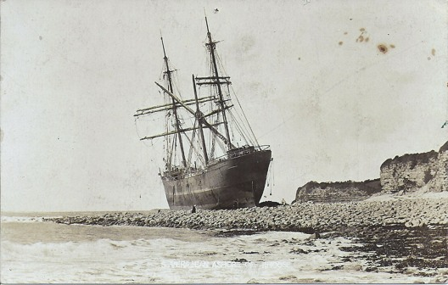

Slide 14
The Cambo, 1912 at Barry Docks
An image of The Cambo which sank at Barry in South Wales in 1912.
Having hit the Eastern breakwater and run aground, she later caught fire and sank.
The ship was later refloated and repaired at Barry Docks.

Slide 15
S S Bengrove 1915
THOUSANDS ON SHORE SEE SHIP BLOWN UP; British Collier Bengrove Is Sunk Without Warning In Bristol Channel. – New York Times
SS Bengrove was a steam-powered collier registered in Liverpool, England. Thousands of people on shore saw her explode and sink in the Bristol Channel on Sunday, 7 March 1915.
The ship left Barry at about 4:00 am under sealed orders and carrying a cargo of 5,000 tons of coal.
Later that day, in the Bristol Channel, about five miles off the coast of Ilfracombe, an explosion occurred under the vessel amidships.
The ship's siren was activated and the crew entered the lifeboats. The siren was heard on shore and the Ilfracombe coast guard sent lifeboats to the area.
There were 21 other steamers in the area at the time of the explosion and six of them offered assistance to the foundering vessel. All 33 crew were saved and taken to Ilfracombe pier.
Early reports were unsure what had caused the explosion. There was speculation that the vessel had struck a mine or torpedo. The cause was later determined to have been a torpedo fired from German U-boat U-20.

Slide 16
Ilfracombe Pier

Slide 17
Pilton 1924
The Pilton was a ship that ran aground on Sully Beach in 1924.
Sully is a village in the Vale of Glamorgan, Wales, lying on the northern coast of the Bristol Channel, midway between the towns of Penarth and Barry and 7 miles southwest of the Welsh capital city of Cardiff.
Owned by WJ Tatem of Cardiff, the Pilton ran aground during gale force winds in December 1924.
She was aground for three months, and provided a steady source of income for Sully caterers from visitors.

Slide 18
The Pilton aground on Sully Beach

Slide 19
Pelican Steamship grounded in 1928
Drawing of the Pelican being launched in 1924.
Grounded on unmarked reef in Minehead Bay, known as the Gables.
Crew rescued by Minehead lifeboat.

Slide 20
Tafleberg 1941
South Wales Podcast.
Imagine it. A merchant ship blown in half by a mine and then simply welded together again so that she could continue to play a role in the effort to keep Britain supplied during the dark days of World War Two. That is exactly what happened to the oil tanker Tafelberg.
Built by Armstrong Whitworth at Newcastle, the Tafelberg was originally a whale factory ship.
Owned by the Kerguellen Sealing and Whaling Company, there was such a shortage of ships that she was converted into an oil tanker soon after war broke out in 1939.
The Tafelberg made several voyages before she struck a mine in the Bristol Channel on 28 January 1941. The ship was relatively close to shore when the mine exploded and was able to signal for assistance.
Several pilot boats and five Cardiff tugs - the Bristolian, Cargarth, Merimac, Standard Rose and Blazer - came to the rescue.

Slide 21
Tafleberg

Slide 22
The Tafelberg was not lucky, however.
Renamed the Empire Heritage, she was torpedoed and sunk on 8 September 1944 by the U 482.
The ship was off Malin Head when she was hit and a large number of crew and passengers went down with her.

Slide 23
S S Walter L M Russ, 1945
Walter L M Russ was a 1,538 GRT cargo ship built in 1927 in Rostock, Germany.
In 1945, she was seized by the Allies and passed to the Ministry of War Transport (MoWT).
It was intended that she would be renamed Empire Concourse but in July 1945 she ran aground between Wales and Ireland, and was wrecked.

Slide 24
Walter L M Russ!! No further info

Slide 25
The end. Now we must look at 1946 to present day!!!

Slide 26
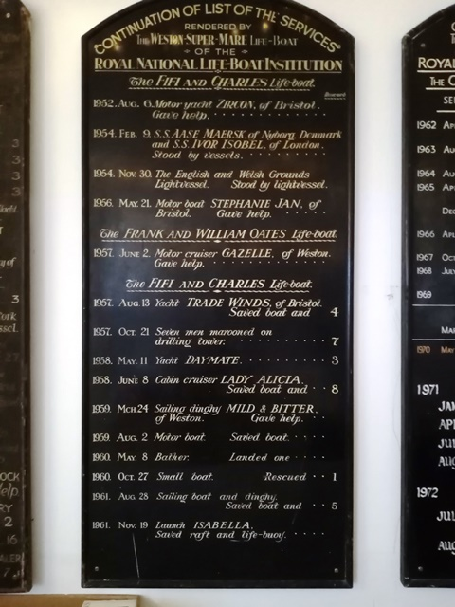
RNLI WESTON SUPER MARE

