Slide 1
History of the Parish of Worle
The Norman Conquest 1066
Domesday Book entry 1086

Slide 2
Family Tree of William the Conquerer
William 1
1066 -1087
Duke Robert William 2 Henry 1 Adela of Normandy [rufus] 1100 -1135 m. Stephen 1087-1100 of Blois
William drowned on Matilda Stephen the White Ship 1120 m. Geoffrey of Anjou 1135-1154
Henry 11
1154 – 1189. First Plantagenet King
Notes:
Dates are the years they were Sovereigns of England. So, Henry 1st was on the throne when we believe that St Martins Church, Worle was being built. We have always been led to believe that AD 1125 was the year when the foundations were laid and the building began. How long did it take to complete it? Goodness knows. Which bits of our church were constructed at this time? Not the tower or the spire. Not the north aisle. The Norman arch inside the porch was there and much of the south wall is still standing.
Stephen put Matilda in the Keep at Arundel Castle, in their battle for the throne.
NB William the Conqueror had 2 more daughter, Adiliza and Cecilia. No room on tree!!

Slide 3
First written mention of WORLE, that I have been able to find!
Notes:
At this point I want to thank Roger Brown, who with his late wife Lesley produced the first of our BLUE BOARDS, entitled Early Worle.
Worle is still spelt the same way. Only Frome can also claim this.
This wonderful document gives us a direct connection with the clerk was responsible for writing our early history across England.

Slide 4
Worle in 1086
Place: Worle
Hundred: Winterstoke
County: Somerset
Total Population: 30 households
Total Tax Assessed: 6.5 geld units
Value to Lord in 1086 £7
Value to Lord c. 1070 had been £11
The land was said to have been ravaged by King Harold’s sons as they fled to Ireland. Hence drop in value between 1070 and 1086.
Notes:
A hundred, is a unit of English local government and taxation, intermediate between village and shire, which survived into the 19th century. Originally, the term probably referred to a group of 100 hides (units of land required to support one peasant family). See info sheet.

Slide 5
1086: The People and their possessions
Households: 22 villagers; 3 smallholders; 5 slaves
Ploughland: 15 ploughlands; 4 Lord’s ploughteams; 9 men’s ploughteams
Other Resources: 3.37 Lord’s lands; Meadow 50 acres; Pasture 13 * 2 furlongs
Livestock in 1086: 1 cob; 24 cattle; 60 sheep
Lord in 1066: Esger the constable.
Lord in 1086: Walter of Douai
Tenant in Chief 1086: Walter of Douai
Phillimore reference: 24.1
The land was said to have been ravaged by King Harold’s sons as they fled to Ireland. Hence drop in value between 1070 and 1086.
Notes:
DOUAI: Do I own this and do I own that!
TENANT In CHIEF: (in feudal society) a tenant who held some or all of his lands directly from the king
PHILLIMORE: Somerset parish registers. Marriages
by Phillimore, W. P. W. (William Phillimore Watts), 1853-1913, ed; Blagg, Thomas Matthews, ed; Seager, H. W., joint editors.
Who was KING in 1086. Still William 1st who died in 1087

Slide 6
Status of the People
Households
The status of households depended on their land and resources. The largest groups recorded are:
Villagers and freemen: around 40% of households, villani, socmani and franci homines were small-scale landholders, owning on average 30 acres of land, and two oxen for ploughing. [22]
Smallholders and cottagers: around 35% of households, bordarii and cotarii owned about 5 acres of land on average and might have had a share in the villagers' plough teams. [3]
Slaves: around 10% of households, servi owned no land of their own, belonged to the lord, and may have been used as ploughmen. [5]

Slide 7
How many folk were living in the area?
Domesday records the heads of families, so the total population was probably around five times larger.
This suggests a population of around 150 souls.
Other households are sometimes noted, including priests, widows, burgesses (townspeople), and Frenchmen (probably a local military presence).
For more information, see the Hull Domesday Project's guide to the peasantry and occupations.

Slide 8
LIDAR OF WORLEBURY HILL
Notes:
Given to me by Bryan Moore.
Bryan Moore, a Worle man was currently studying at Oxford, did a talk for us about his research into the development of Worle from 400 AD to 1800 AD, using LIDAR technology.
[Light Detecting and Ranging] which enables archaeologists to see through surface vegetation and construction.]
Bryan’s thoughts on Pre-Norman Worle are available . Copies by the full side LIDAR

Slide 9
Aerial taken in 1946
Notes:
Dave Hart, Worle History Society’s esteemed chairman, and I visited the National store of aerial pictures in Swindon [ask Dave what its called] and purchased 2 photos for the use of WHS. They have been invaluable. This one was taken in July 1946 and gives us a marvellous view of Worlebury Hill and Worle Village.

Slide 10
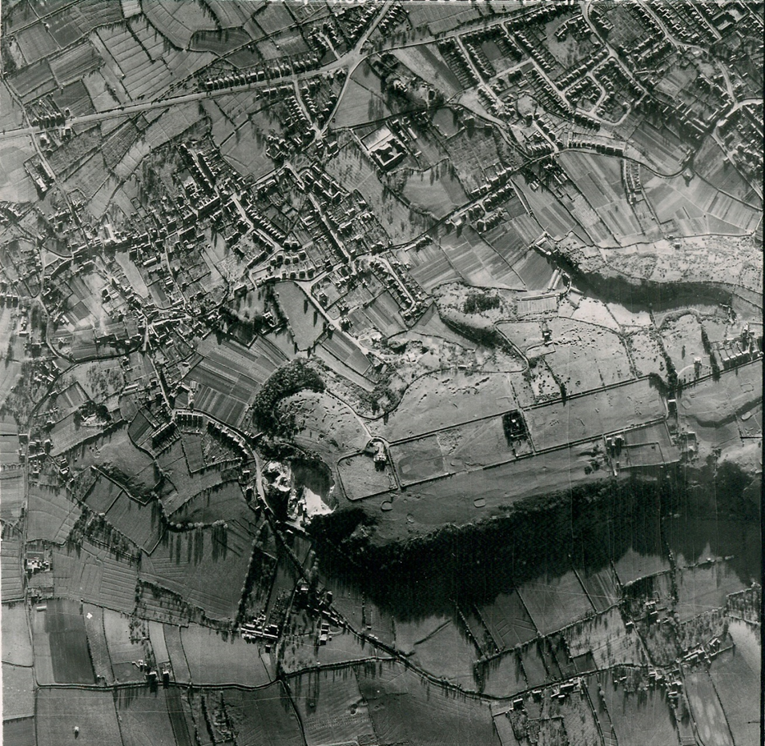
LIDAR and AERIAL
Notes:
At this point ask who has a computer, etc.
Suggest that they take a closer look at the LIDAR of the hill.

