Slide 1
Norman Architecture
The term Norman architecture is used to categorise styles of Romanesque architecture developed by the Normans in the various lands under their dominion or influence in the 11th and 12th centuries. In particular the term is traditionally used for English Romanesque architecture.

Slide 2
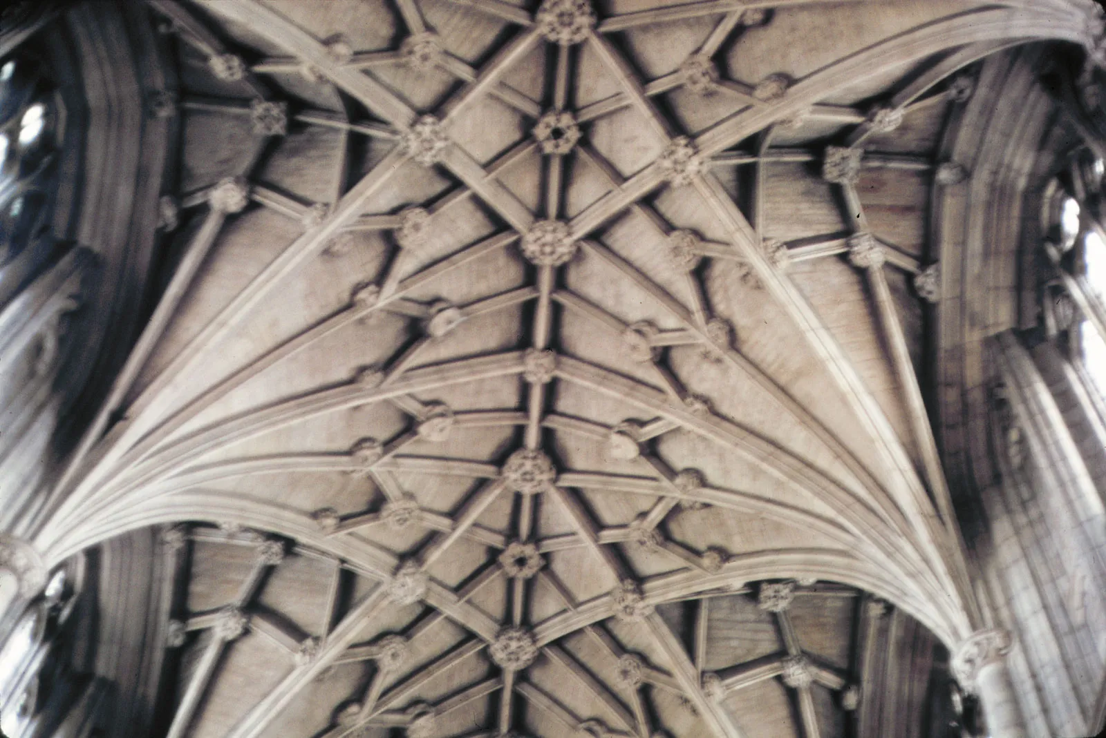
Ceiling Vaults: Winchester Cathedral

Slide 3
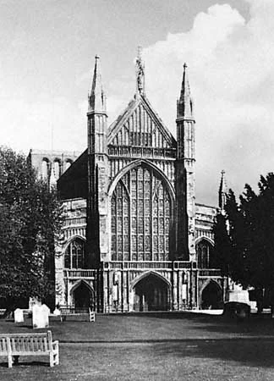
Front View: Winchester Cathedral

Slide 4
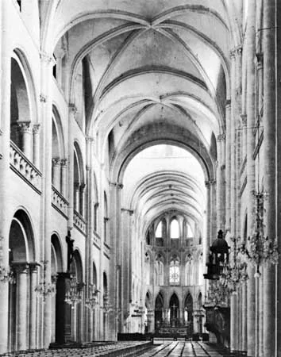
St Etienne, France: Church Nave

Slide 5
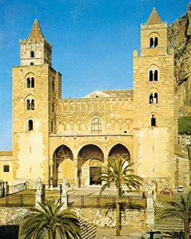
Norman-cathedral-Cefalu-Sicily

Slide 6
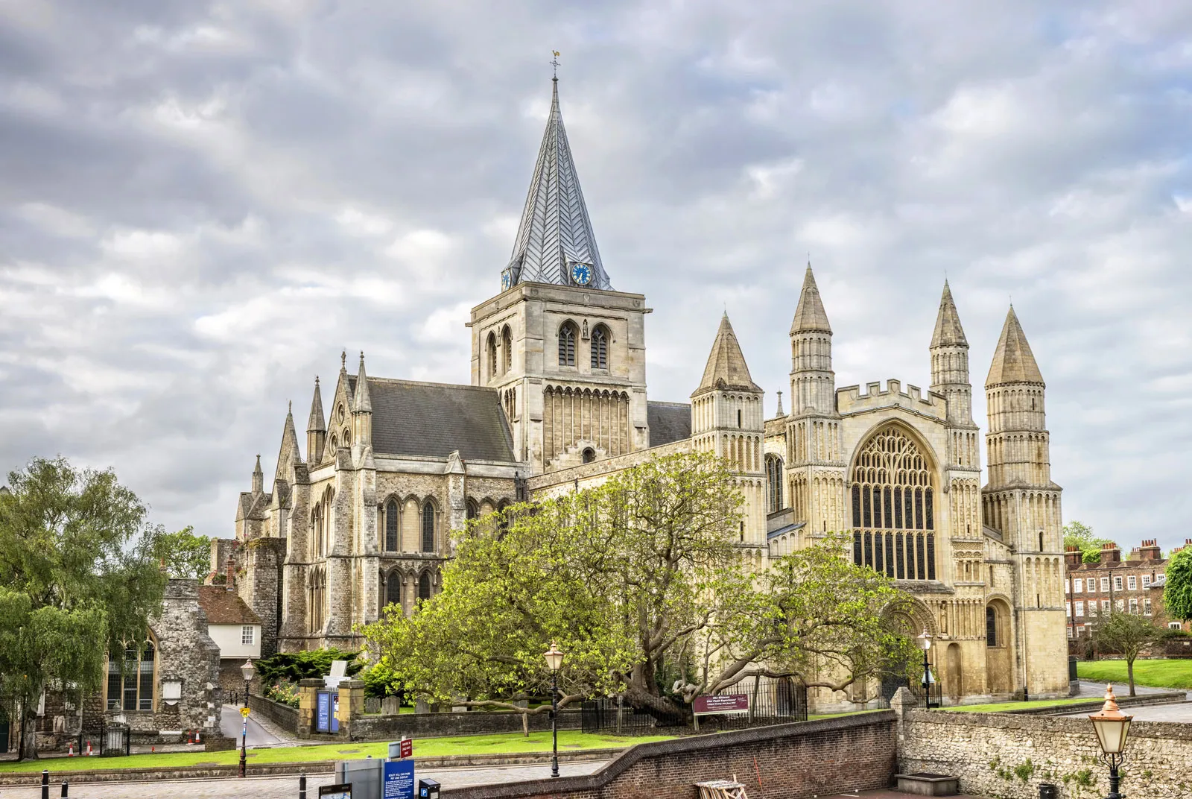
Rochester Cathedral: England

Slide 7
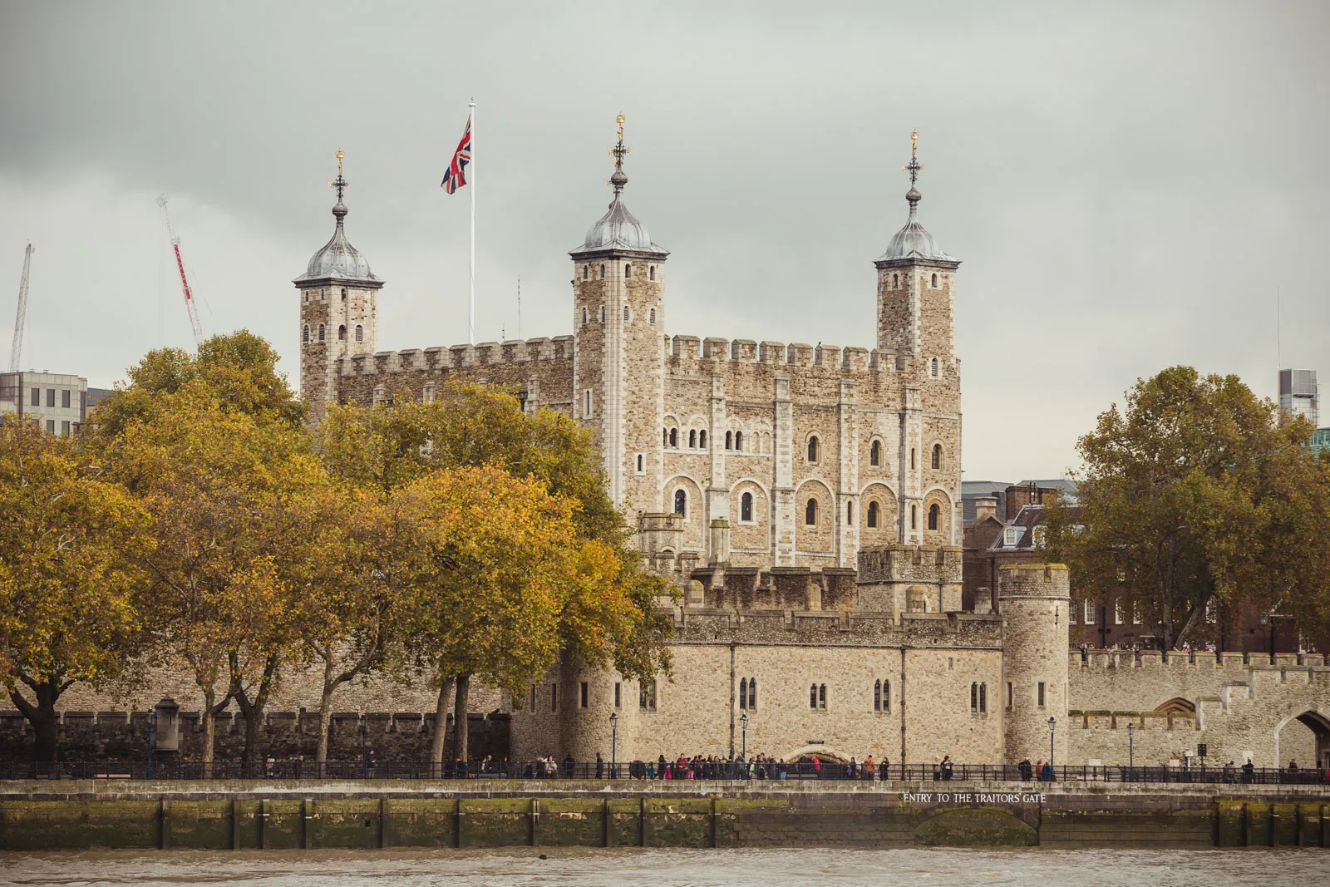
Tower of London

Slide 8
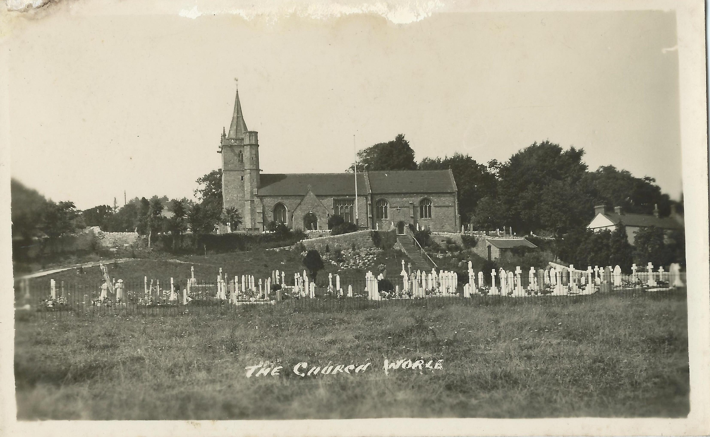

Slide 10
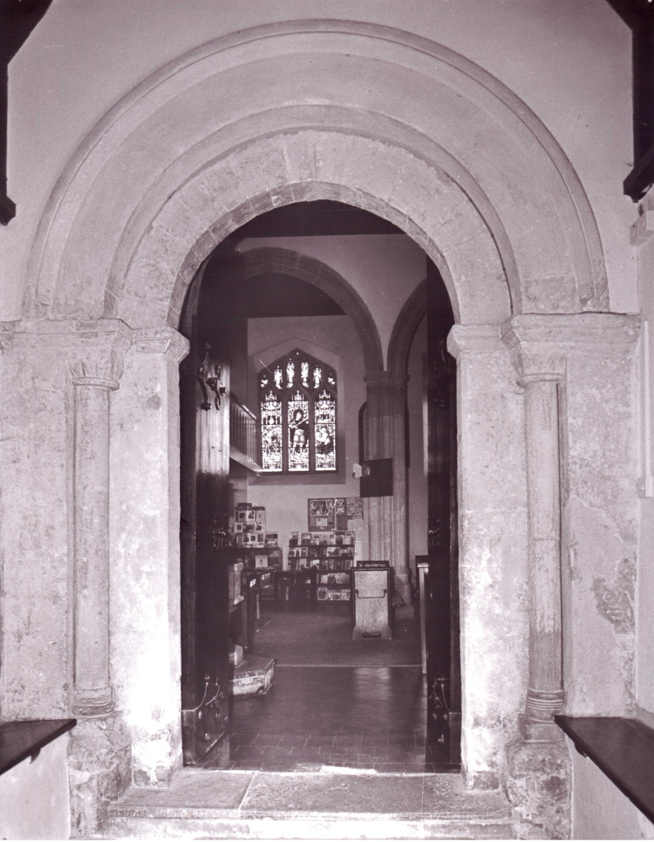
The Norman Arch on the south facing wall Jenny and Stanley Thompson

