Slide 1
Coronation Year in Worle
2nd June 1953

Slide 2
Queen Elizabeth 11 Then and Now

Slide 3
12 inch television sets were black and white

Slide 4
But Westminster Abbey was full of colour

Slide 5
Silly cricket to raise money for the party

Slide 6
Brownies planting red, white and Blue flowers around the Church Hall

Slide 7
Worle Carnival. May 28th. Coronation Coach pulled by a pony and a donkey!!

Slide 8
Carnival Queen and her maids

Slide 10
Worle Junior School celebrated with a pageant of Kings and Queens

Slide 11
Mums dressing Henry the 8th

Slide 12
Old time dancing and a big audience

Slide 13
The boys helped to build the castle

Slide 14
Dancing round the Maypole

Slide 15
And now the same in colour

Slide 16
Servants for the day

Slide 17
Dressed as Scottish, Welsh and Irish

Slide 18
Here come the troops ready for battle

Slide 19
Marion Jones played Elizabeth 1st

Slide 20
The Maltings on Coronation Day

Slide 21
Church Farm won the competition for best cottage

Slide 22
Greenwood Cottages. I think these are better. More flags.

Slide 23
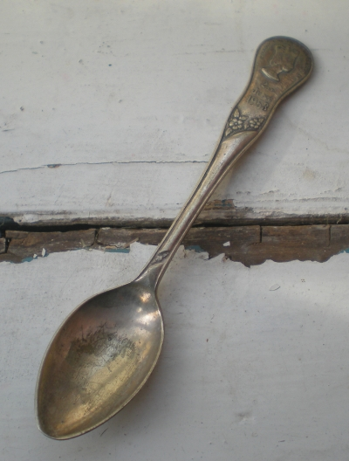
Coronation mug and a spoon for each child

Slide 24
Heavy rain in London on Coronation day

Slide 25
Model Coronation Coach My parents brought one back for me, but I didn’t take to it much and I lost it.

Slide 26
Thousands of cardboard periscopes were used to see the Queens coach

Slide 27
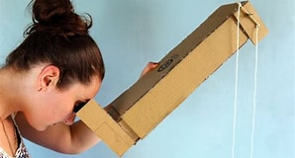
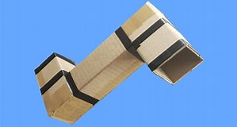
How to make a periscope
https://www.youtube.com/watch?v=Bnjn5e4LTmE
Have a look on YouTube.
Really good school project.

