Slide 1
Worle High Street from Lawrence Road to Ebdon Road
Photographs through time with an attempt at dating and analysis

Slide 2
Lawrence Road to New Bristol Road 1930 ish

Slide 3
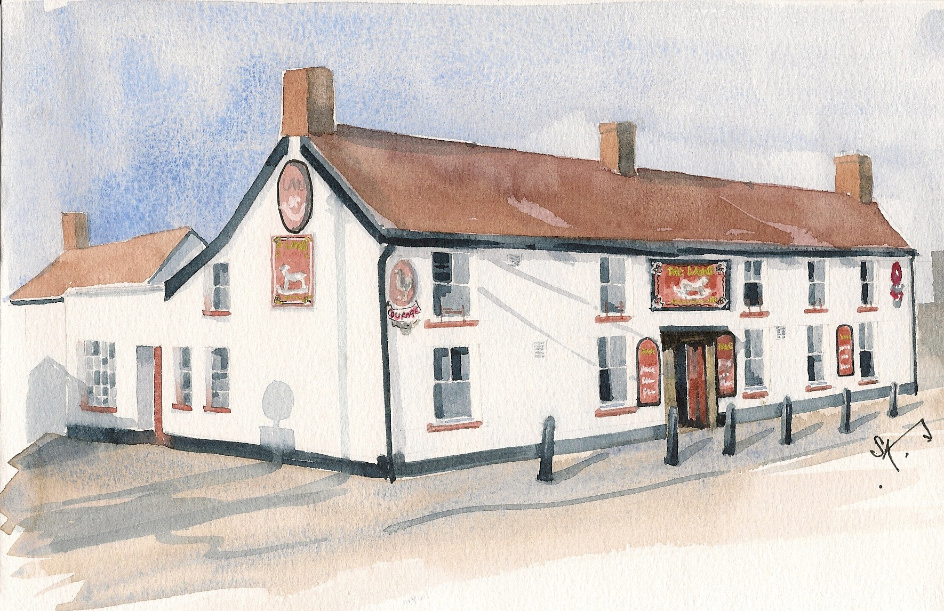
The Lamb Inn

Slide 4
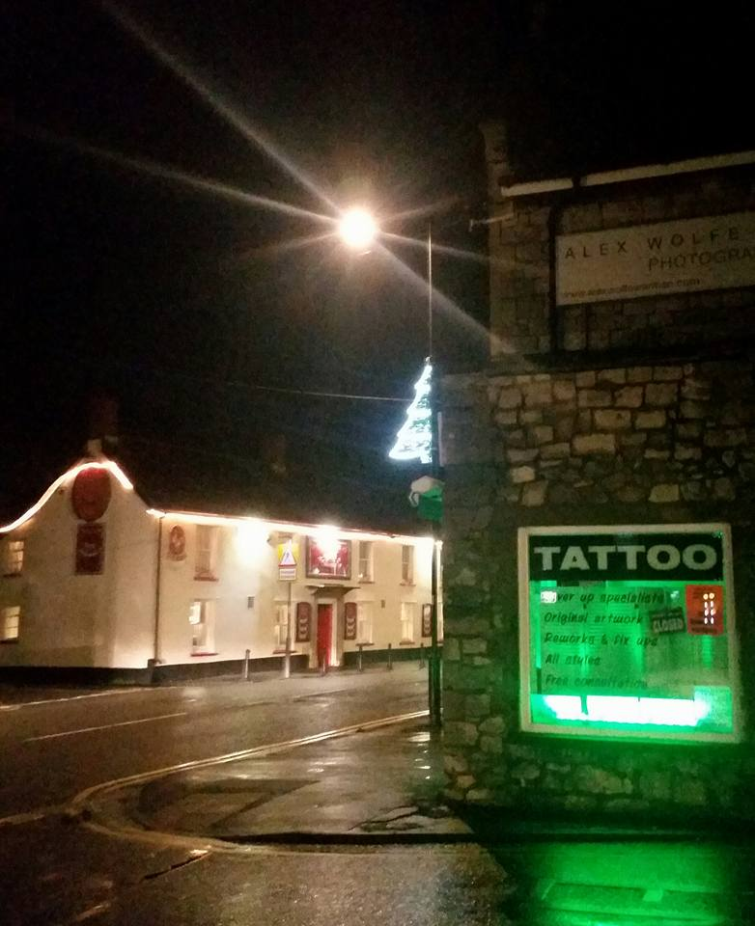
The Lamb Inn in 2016

Slide 5
Lamb Inn, Lower Street!

Slide 6
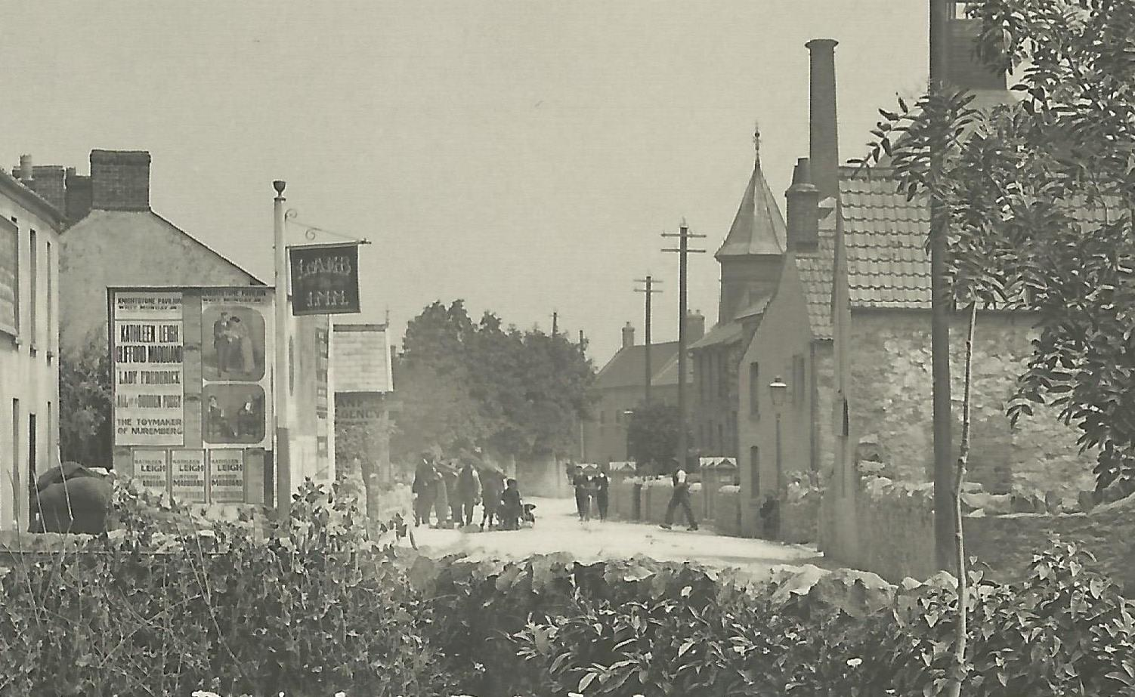
1914: High St. facing east.
Notes:
The toymaker of Nuremburg, a play in 3 acts was on at the Knightstone starring Kathleen Leigh and Clifford Marquand [or close].

Slide 7
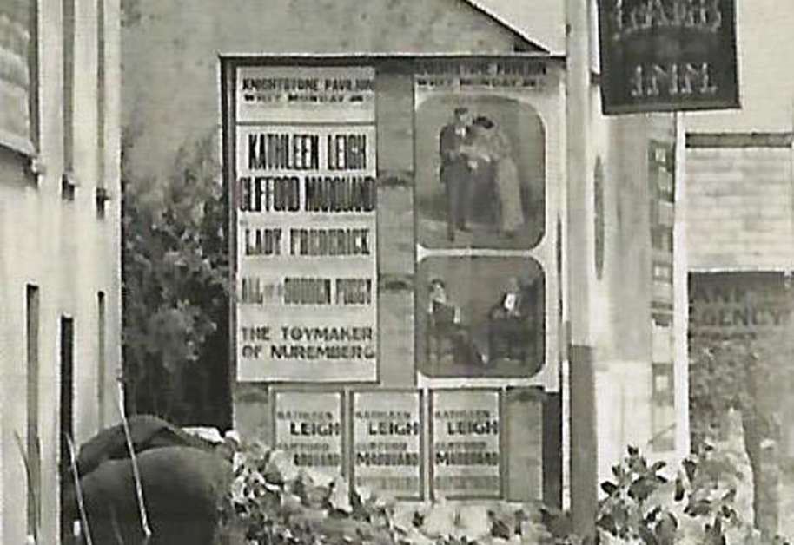
February 1914, possibly
Notes:
The Toymaker of Nuremberg was written in 1881.
No trace of Kathleen Leigh or Clifford Marquand
However possibly February, 1914. Mentioned in ‘The Era, London’ with no Christian names, but it seems they were touring. Previous theatre was in Wolverhampton.

Slide 8
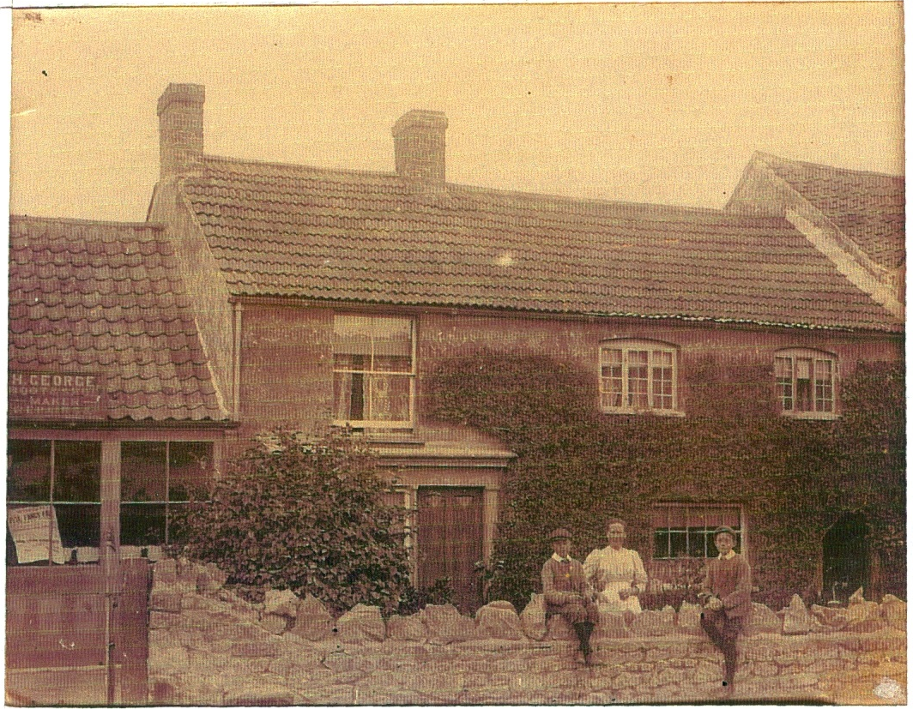
1907: Len, Alice and Eli George
Notes:
North side of High Street, roof of Banwell House on far right.

Slide 9
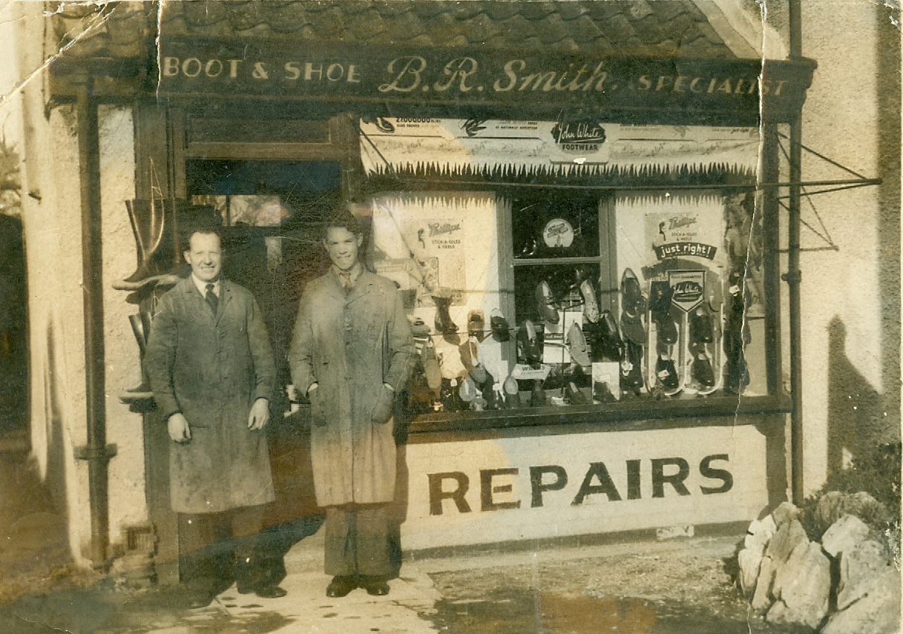

Slide 10
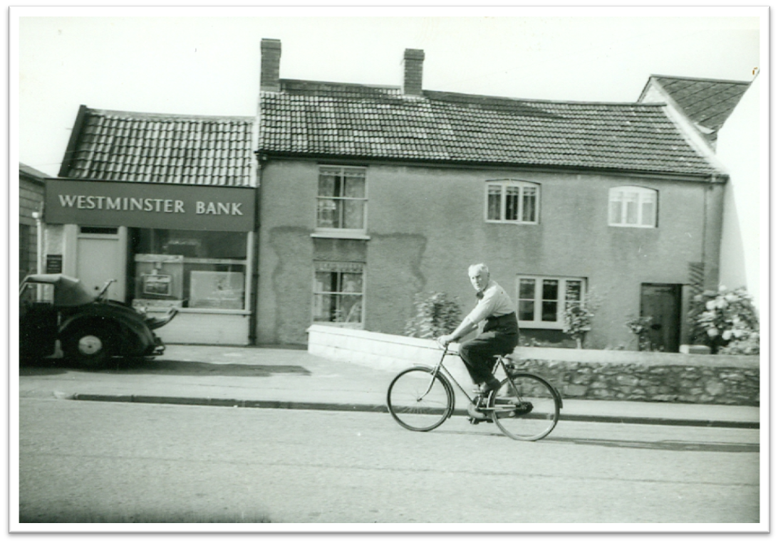
Len George on his bike!

Slide 11
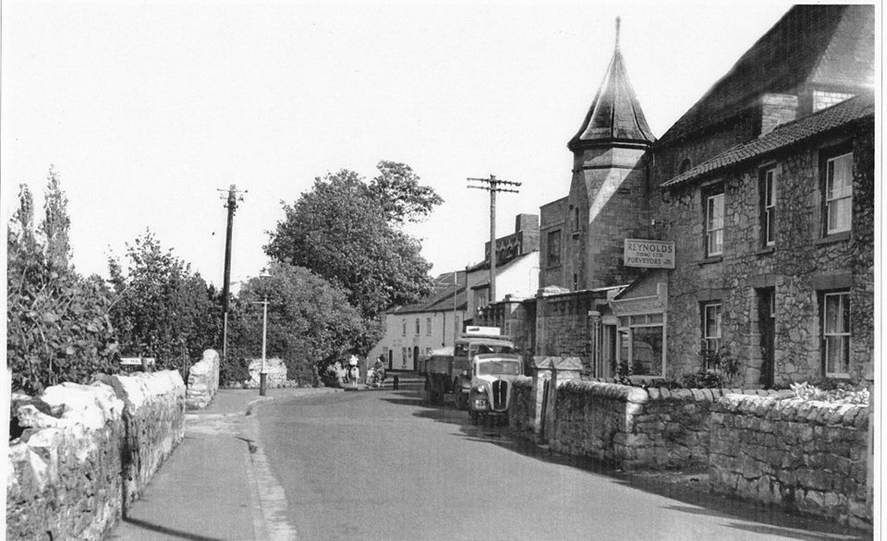
1955
Notes:
Maltings sign on left.
Reynolds the butchers on right.

Slide 12
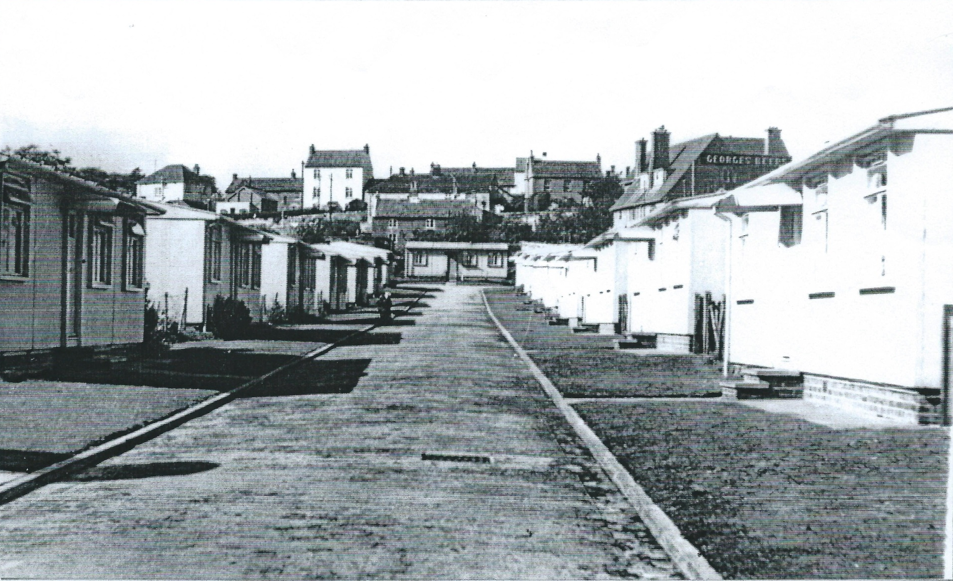
The Maltings

Slide 13
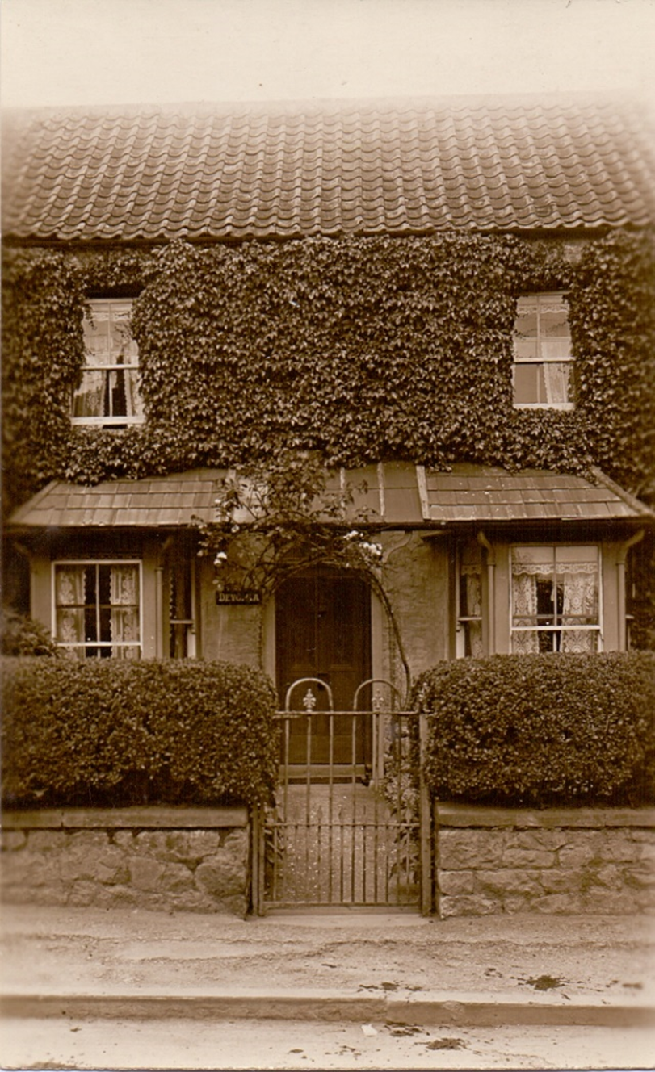
Devonia House just about on the site now occupied by Fairsave.

Slide 14
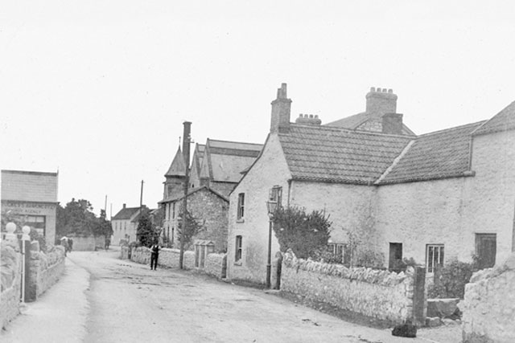
Approx. 1907/8 looking east towards the New Inn
Notes:
Roof and chimney of Primrose House/cottage shows above the rest towards the right

Slide 16
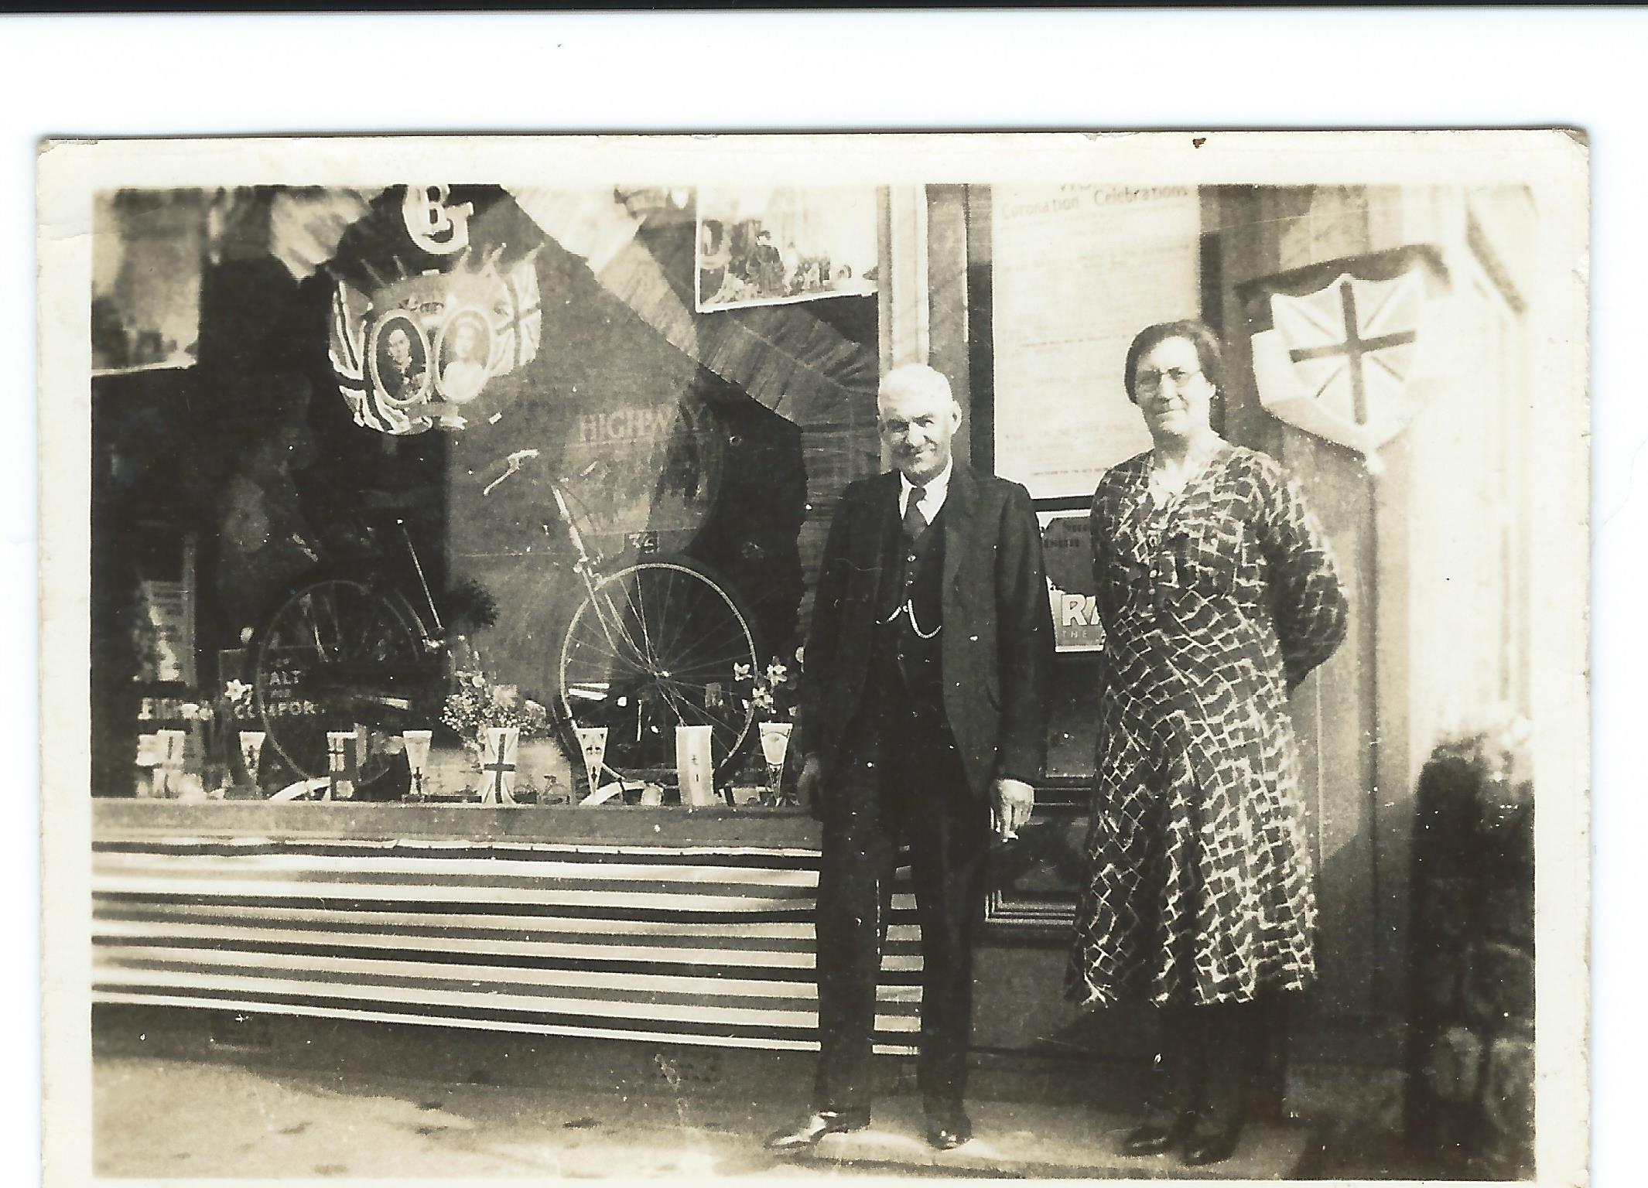
Decorated for Coronation of George VI on 12th May, 1937

Slide 17
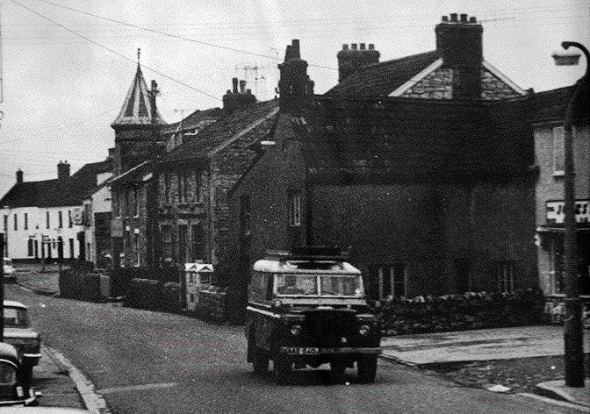
1970: South side of High Street with Jones’s newsagents far right
Notes:
Notice the roof line of Elm House for reference. Jones’s newsagents is set back slightly from the site of the old cycle shop.

Slide 18
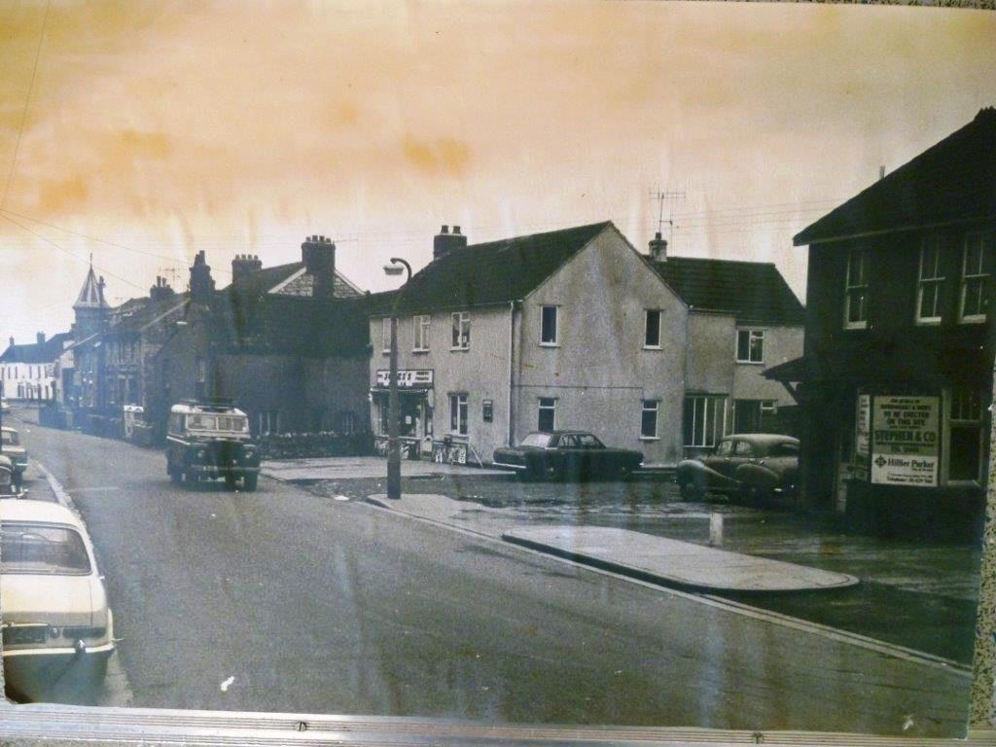
Jones’s newsagent in 1970

Slide 19
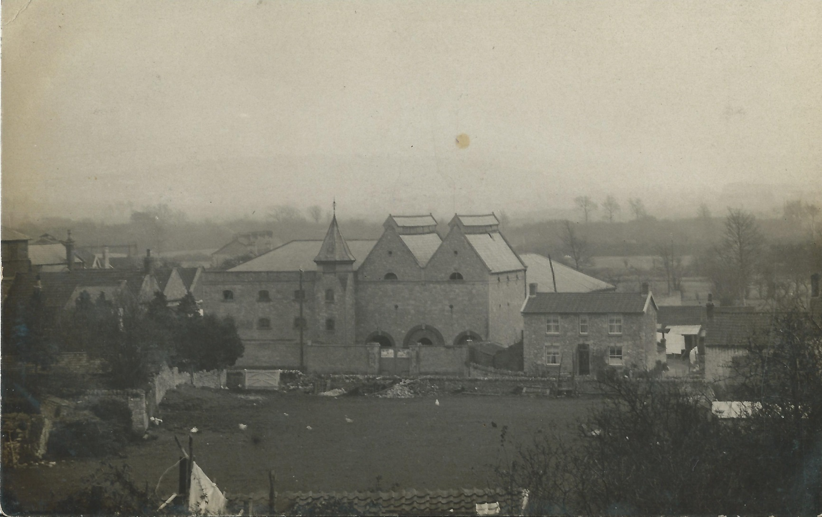
1941 Castle Paints before ‘The Maltings’ was built in 1950
Notes:
Postcard dated 1941
Primrose Cottage still standing. Vera Edward’s home.
Field in foreground now the site of Worle Library and the attendant shop premises.

Slide 20
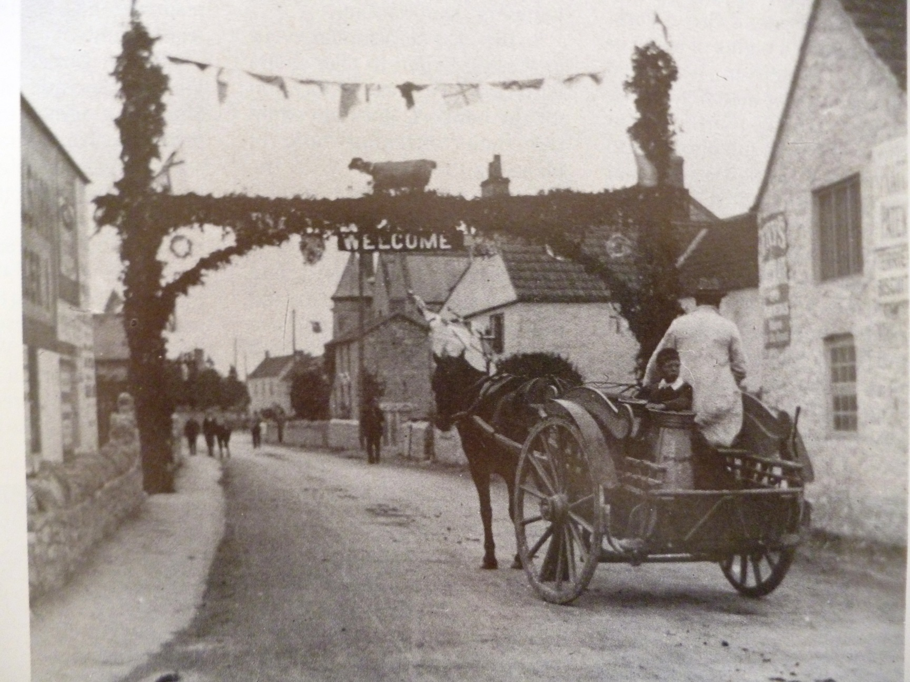
1902: Arch advertising sheep shearing contest to celebrate the coronation of Edward VII

Slide 21
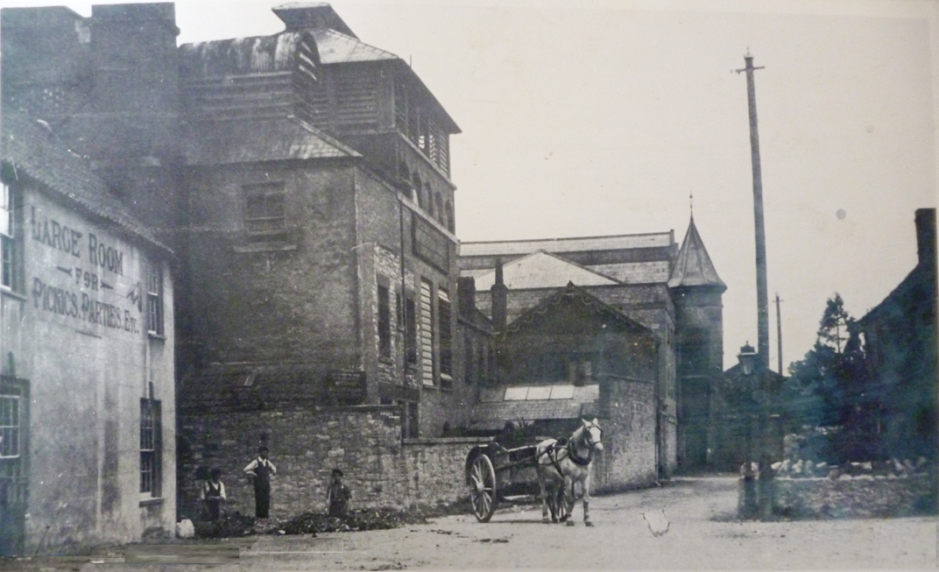
Very early, but not dated yet. Likely to be around 1902

Slide 22
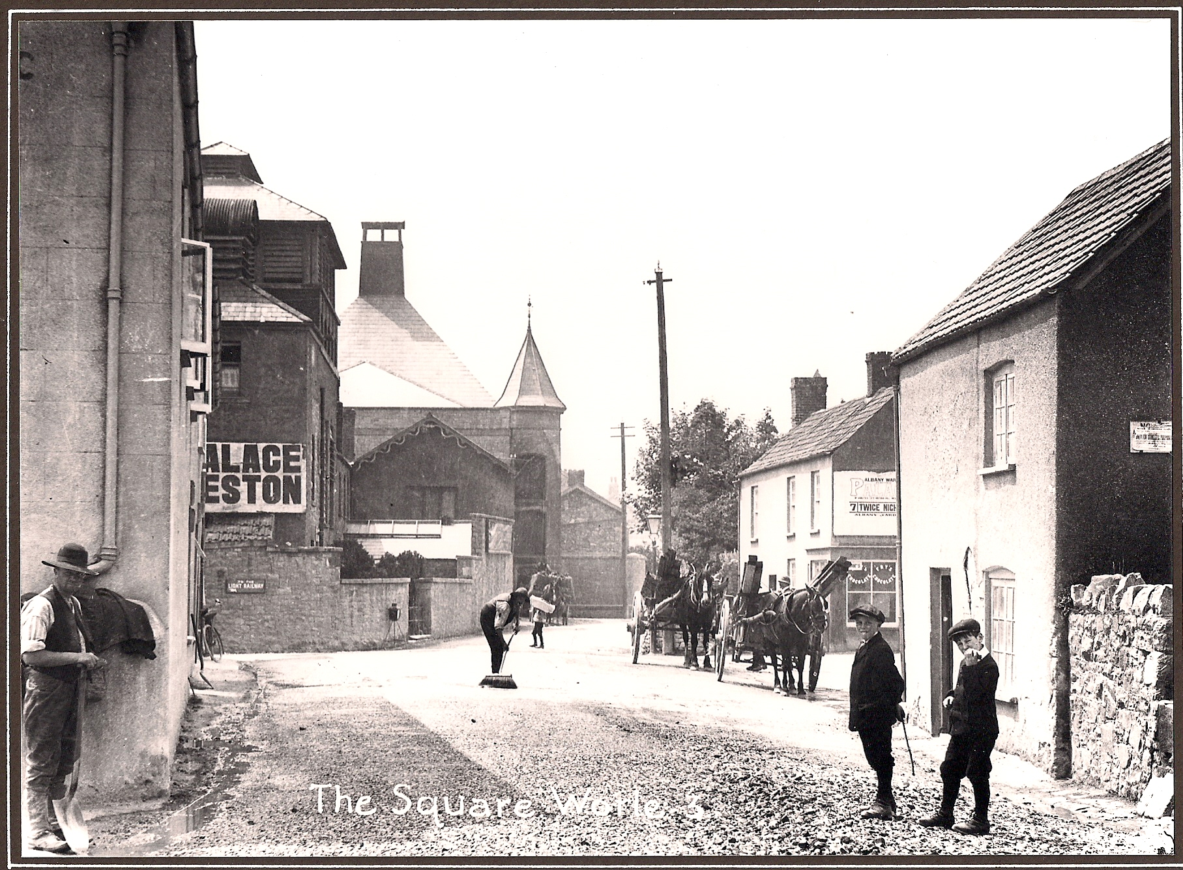
The Square, 1907

Slide 23
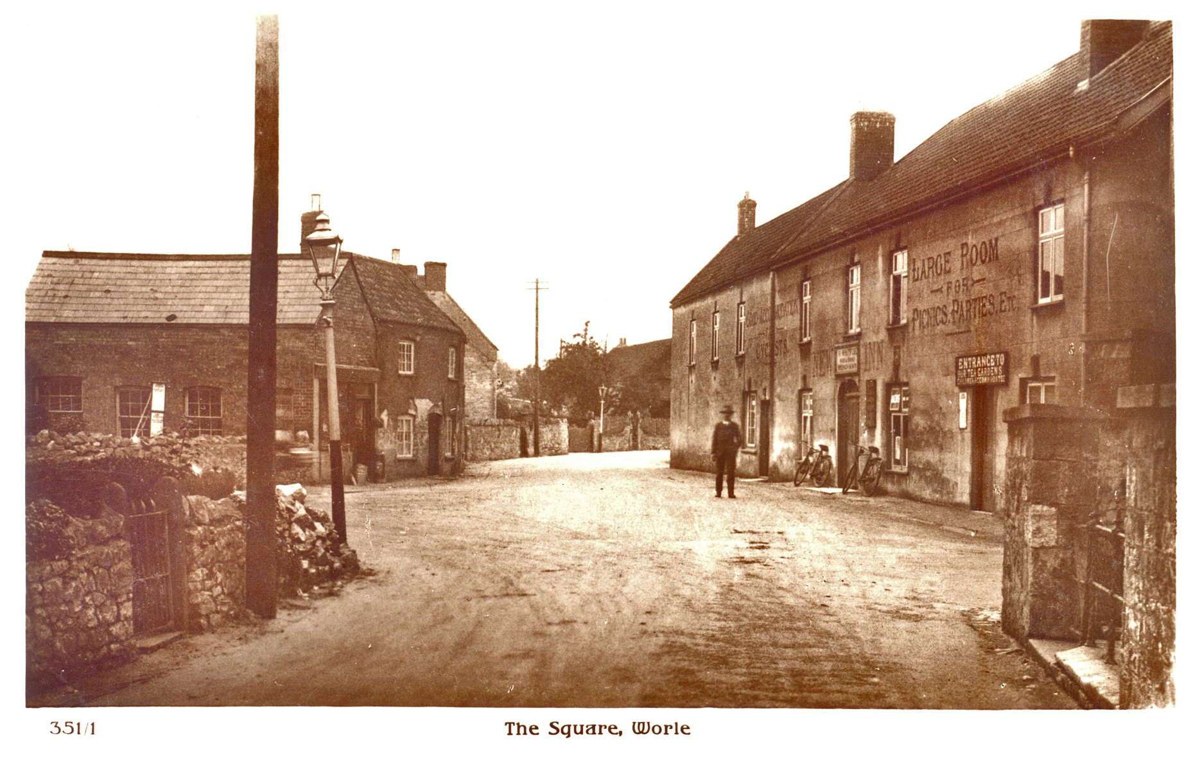
The Square in the early 20th century

Slide 24
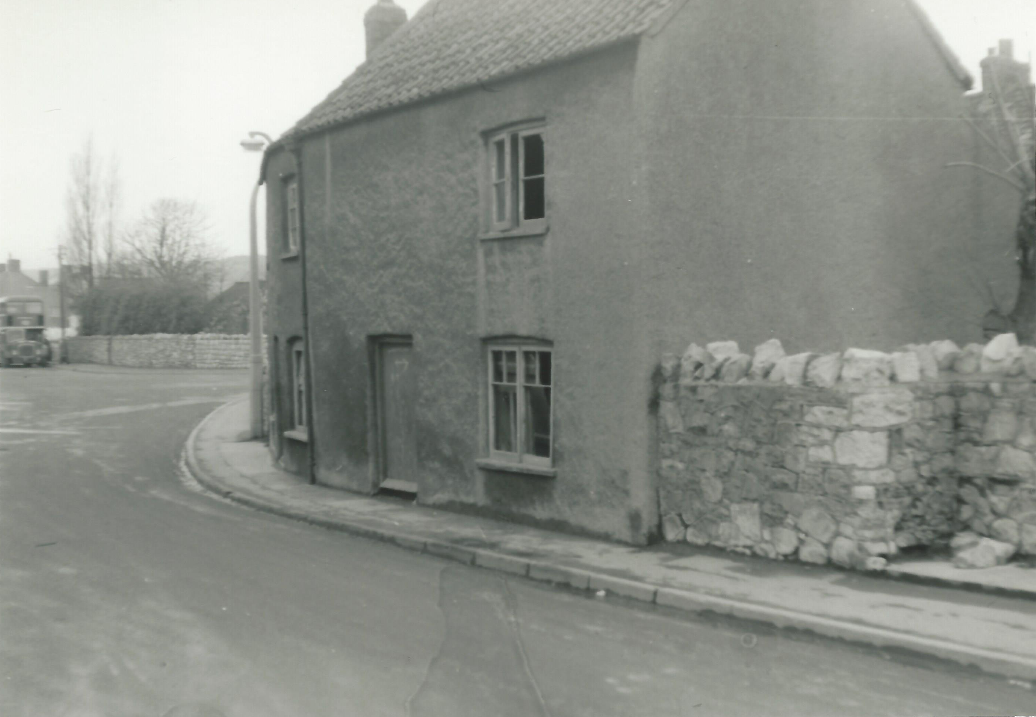
1960 The ‘terminus’

Slide 25
Village Pump 1919

Slide 26
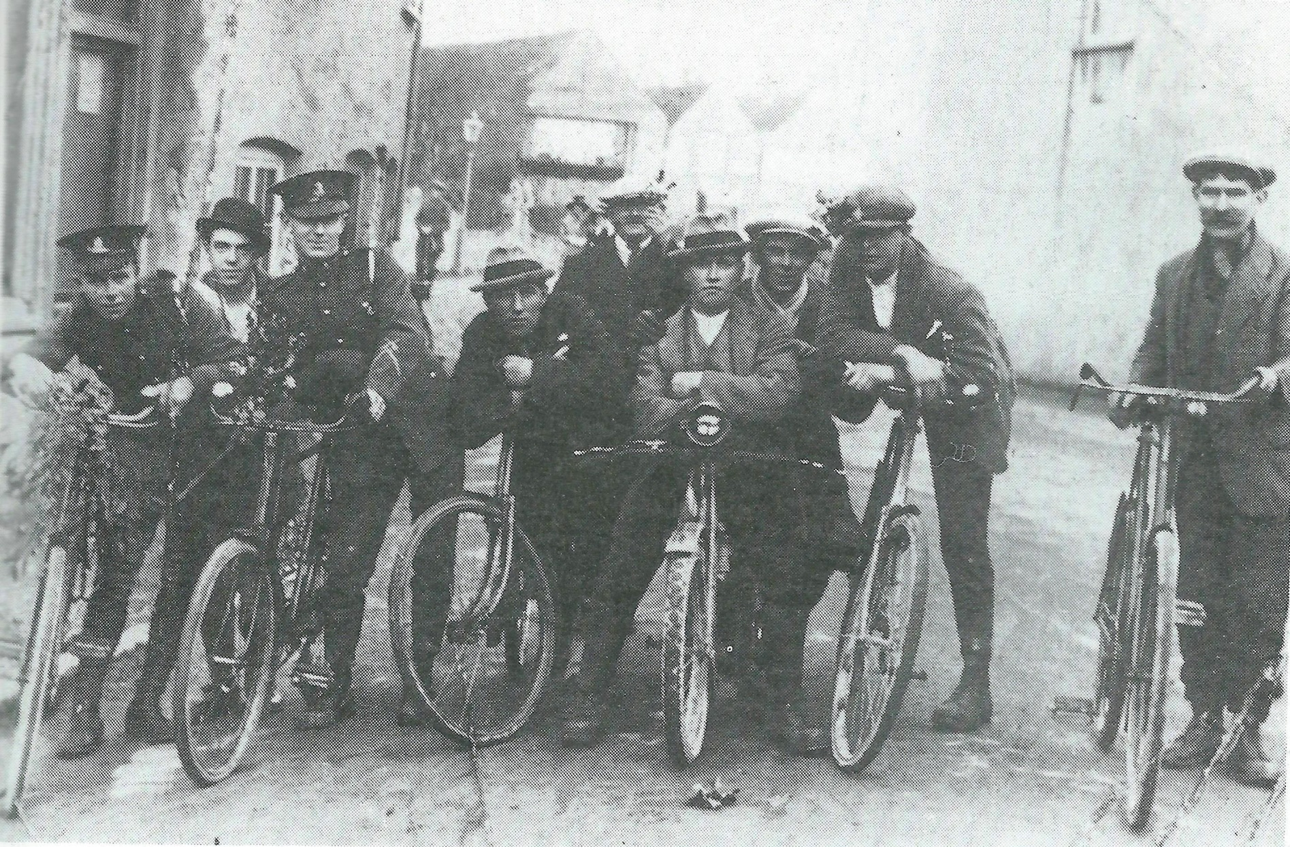
Home from World War 1. Curved cottage on left should be familiar now.

Slide 27
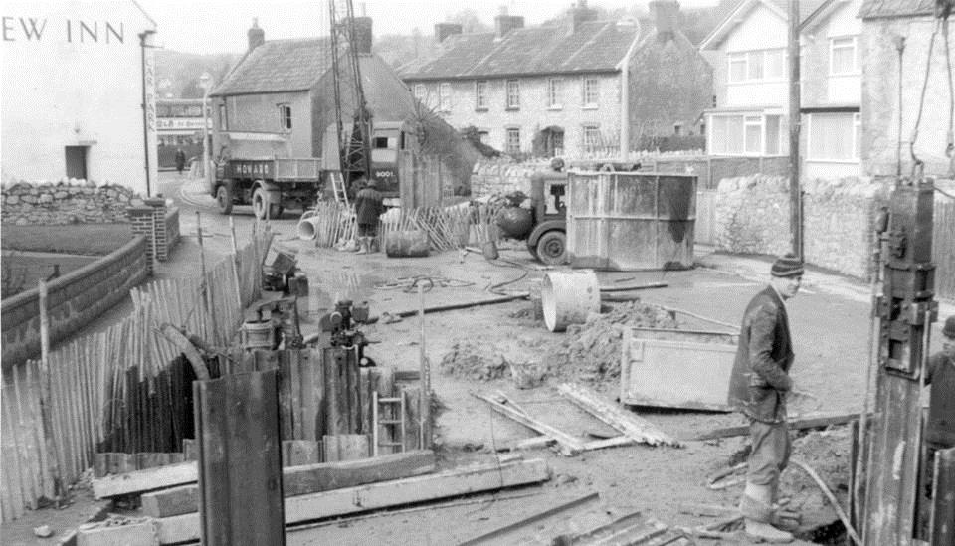
1958. Road Works
Notes:
From Robin Wild’s collection.

Slide 28
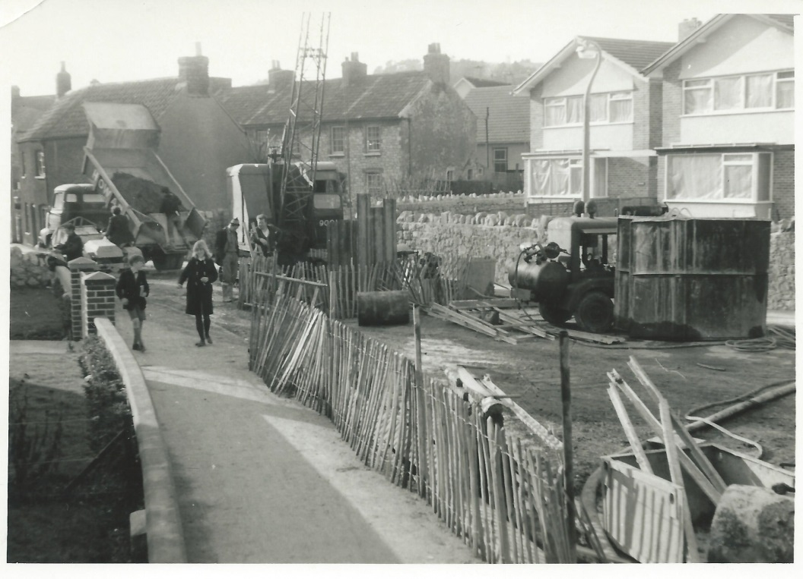
1958: Road Works west of Ebdon Road junction and the Rose Gardens

Slide 29
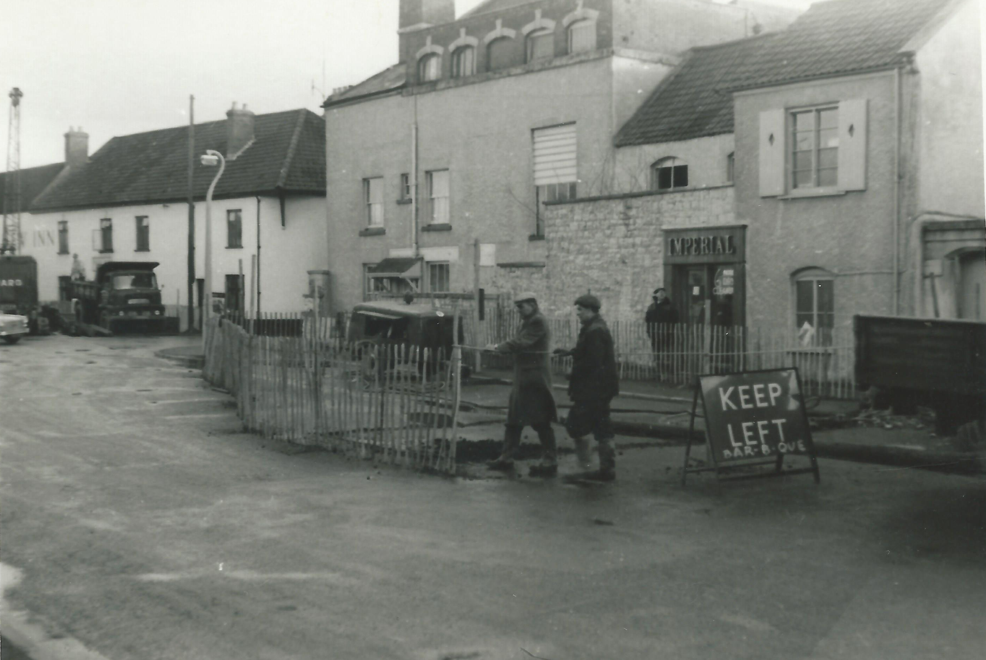
April 1964

Slide 30
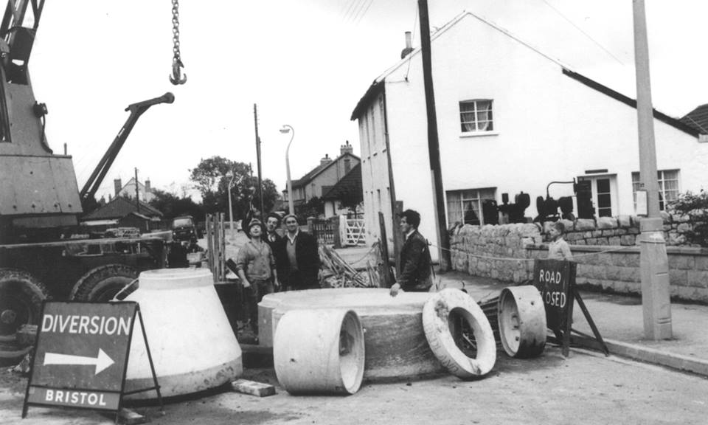
1964: Colebridge House and yet more sewage works

Slide 31
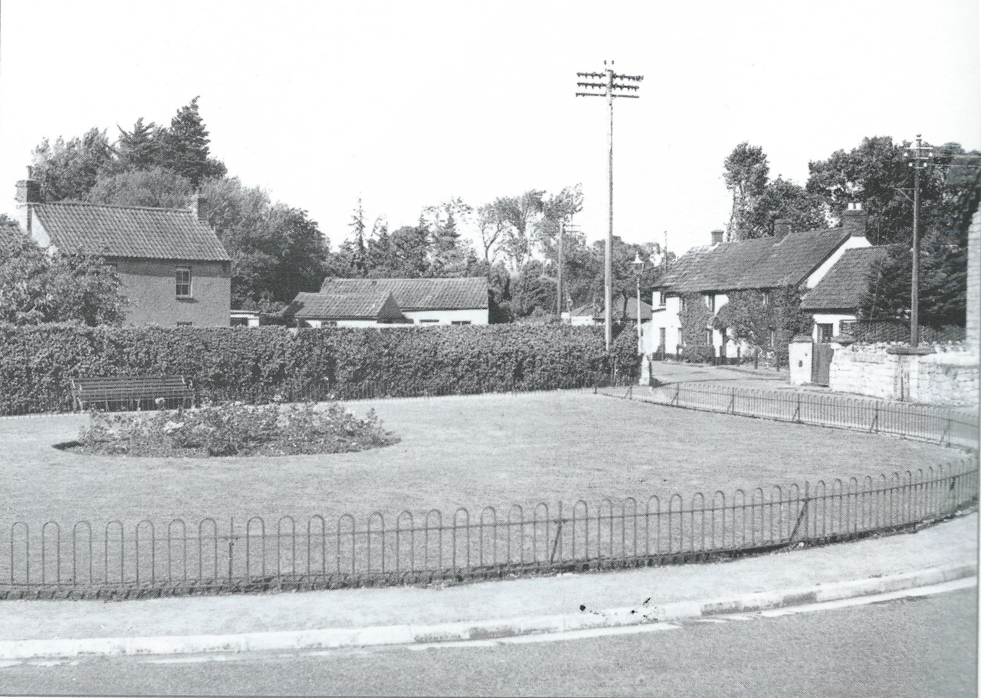
Rose Gardens and Ebdon Road in 1960

